Slide 1
PRELIMINAR BIOINFORMATHICS ANALYSIS RESULTS SKI-PROJECT 2024
Claudia Botello Muñoz
Centro Pfizer-Universidad de Granada-Junta de Andalucía de Genómica e Investigación Oncológica (GENYO)

Slide 2
GENE ONTHOLOGY: BIOLOGICAL PATHWAYS
R packages used:
clusterProfiler: version 4.10.1
AnnotationDbi : version 1.64.1
org.Hs.eg.db : version 3.18.0
readxl : version 1.4.3
Software used:
R: version 4.3.3

Slide 3
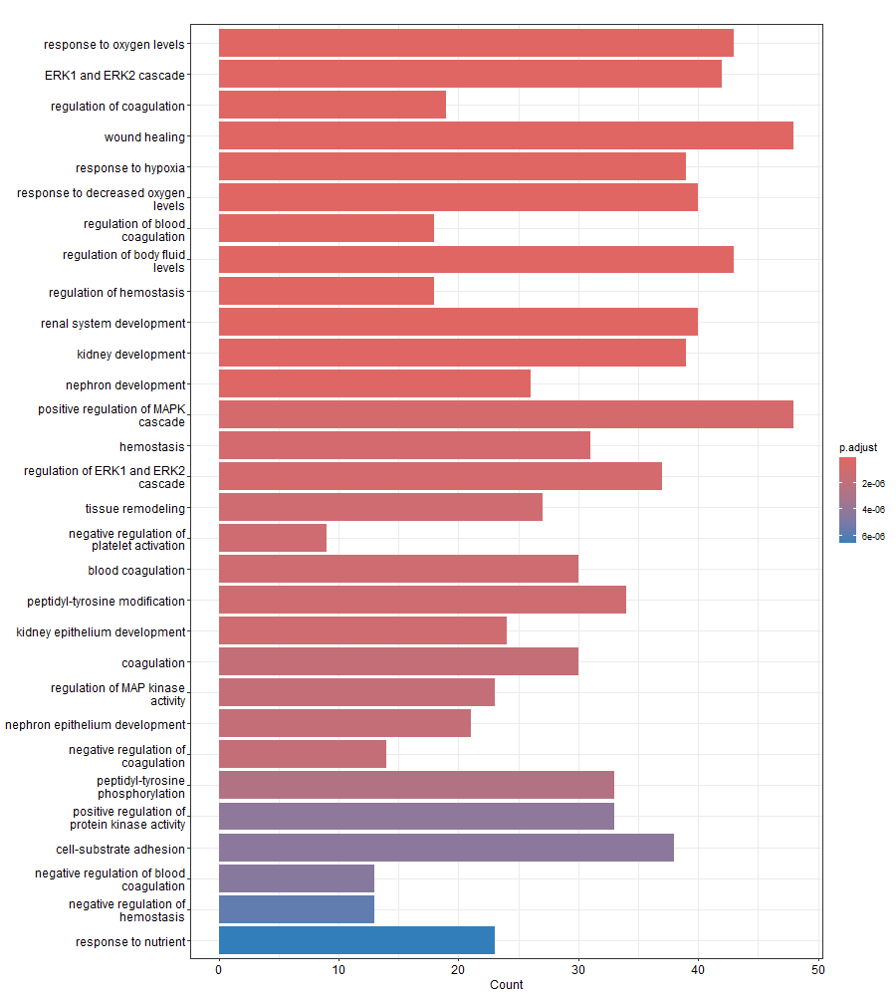
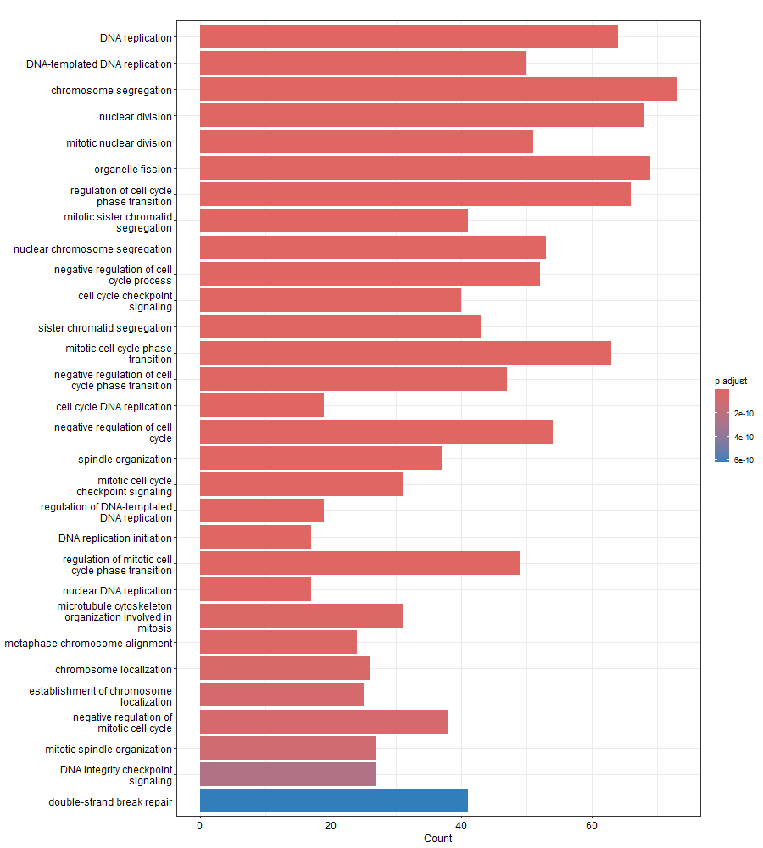
WT_TGF_SGS_TGF
mRNA
Upregulated genes
Downregulated genes
Notes:
Parameters:
Pval < 0.05
log2FC :
Up: log2FC > 0.5
Down: log2FC < -0.5

Slide 4
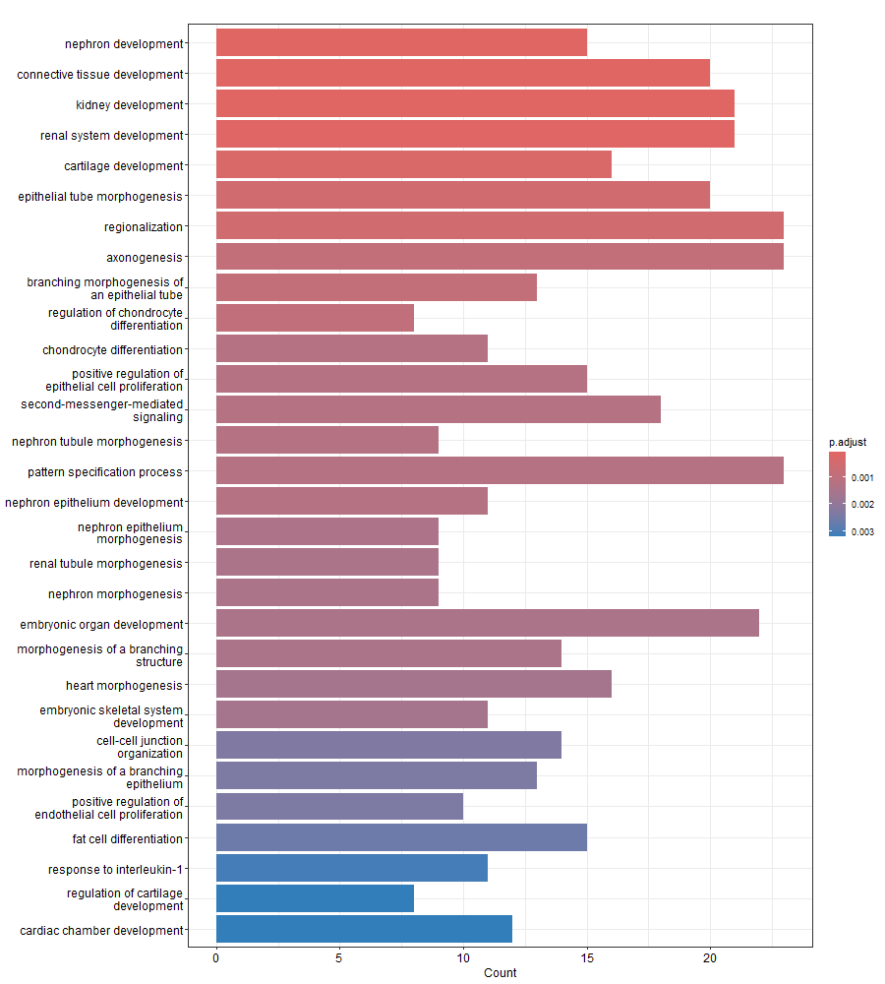
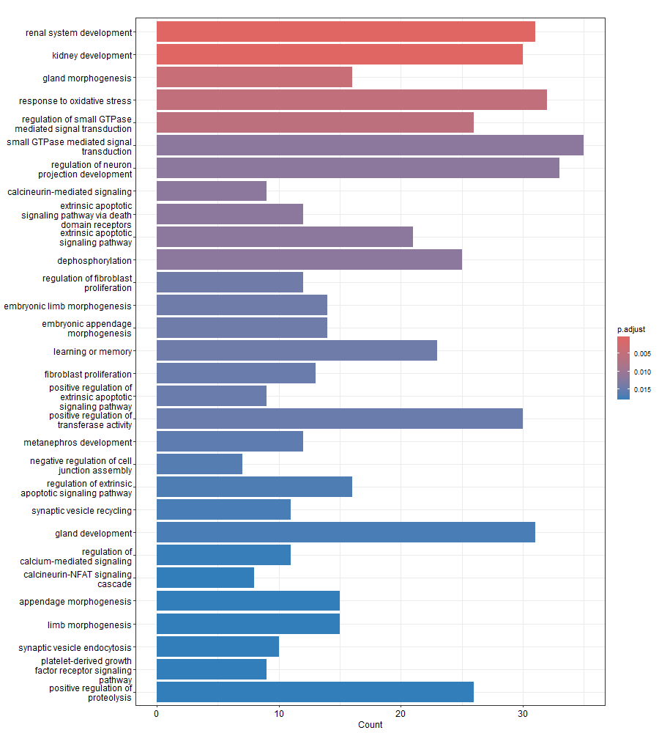
mRNA
WT_TGF_LOF_TGF
Upregulated genes
Downregulated genes
Notes:
Parameters:
Pval < 0.05
log2FC :
Up: log2FC > 0.5
Down: log2FC < -0.5

Slide 5
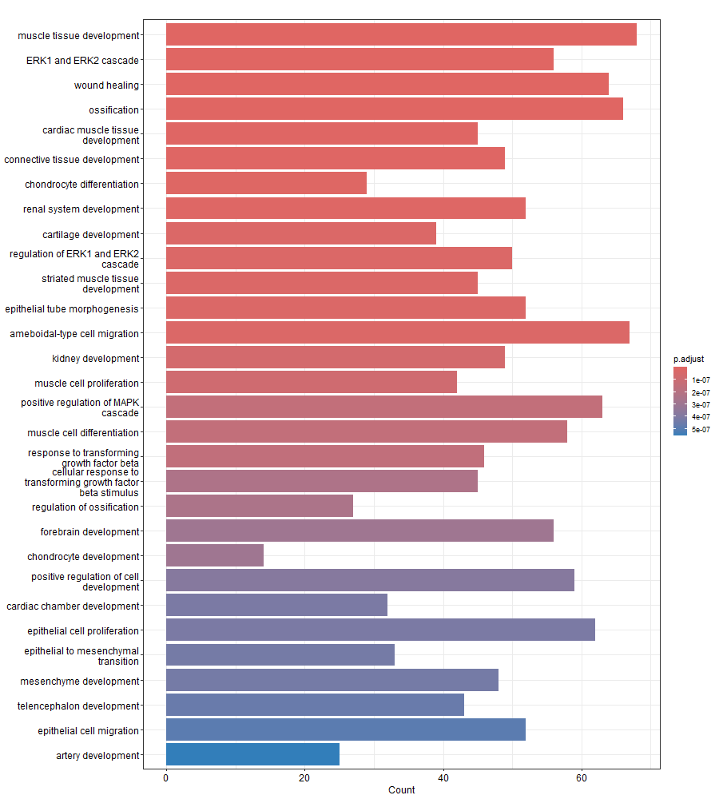
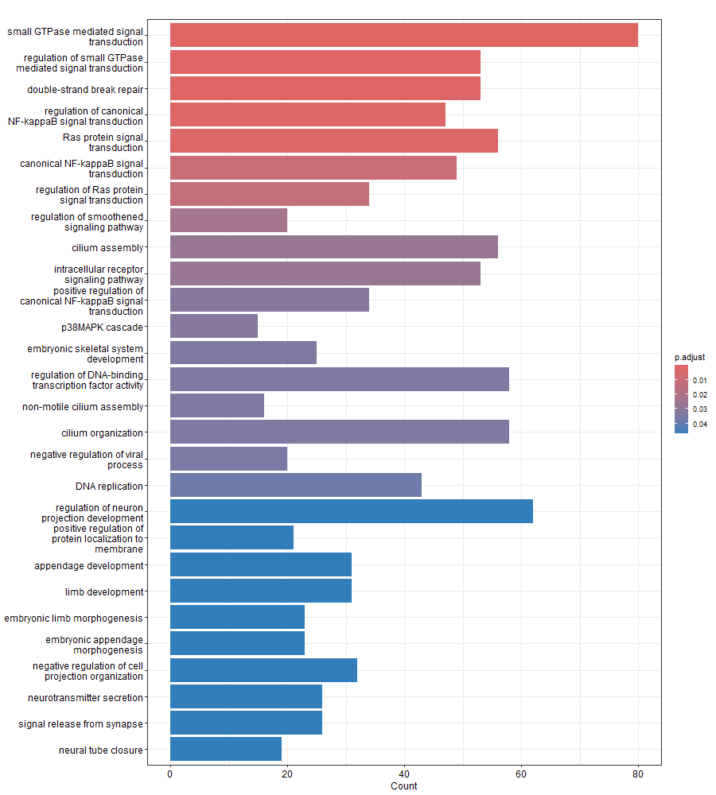
WT_SB_WT_TGF
mRNA
Upregulated genes
Downregulated genes
Notes:
Parameters:
Pval < 0.05
log2FC :
Up: log2FC > 0.5
Down: log2FC < -0.5

Slide 6
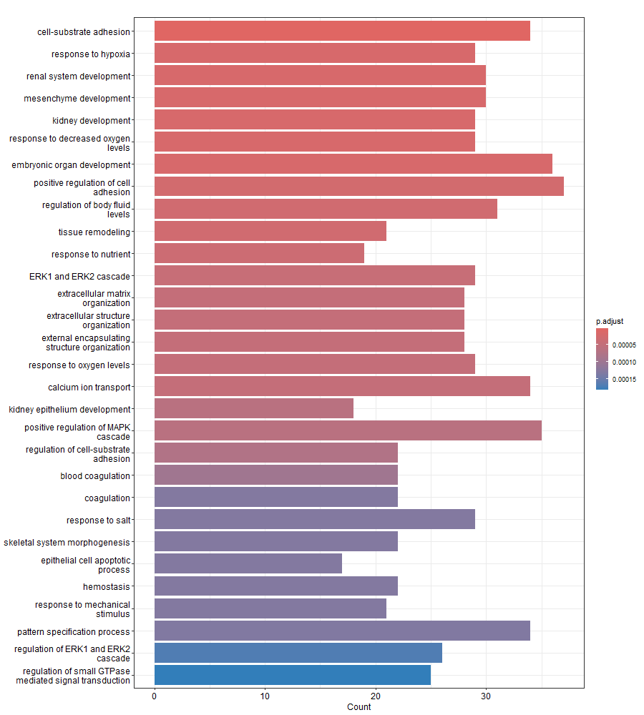
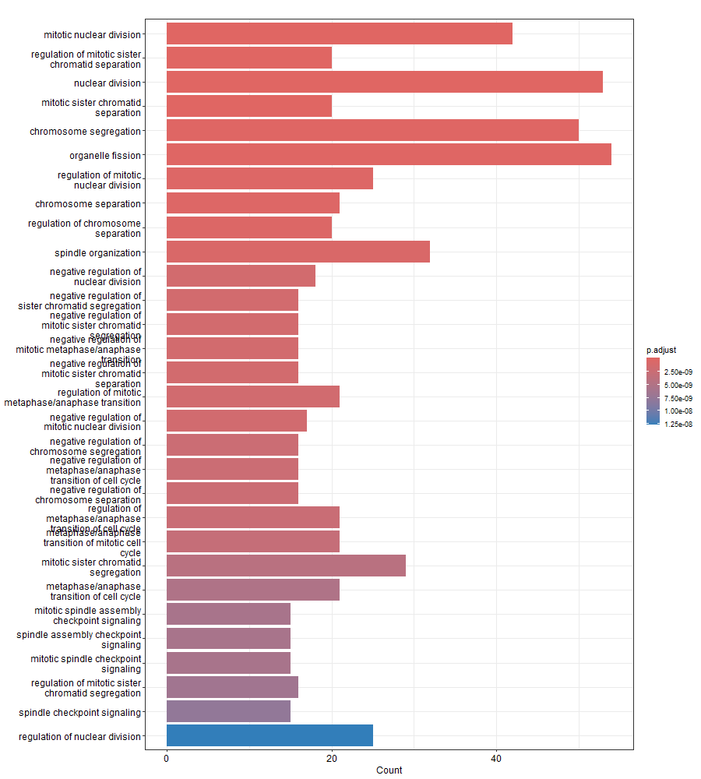
WT_SB_SGS_SB
mRNA
Upregulated genes
Downregulated genes
Notes:
Parameters:
Pval < 0.05
log2FC :
Up: log2FC > 0.5
Down: log2FC < -0.5

Slide 7
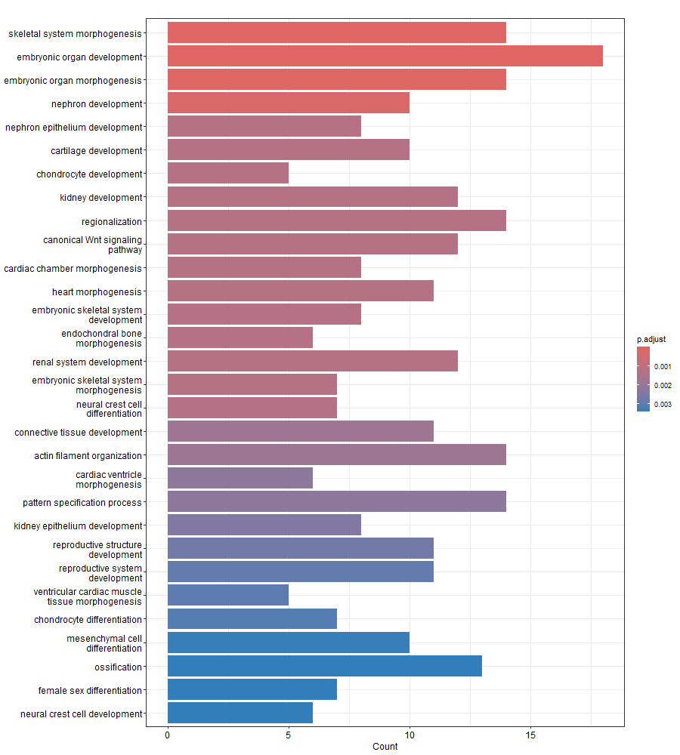
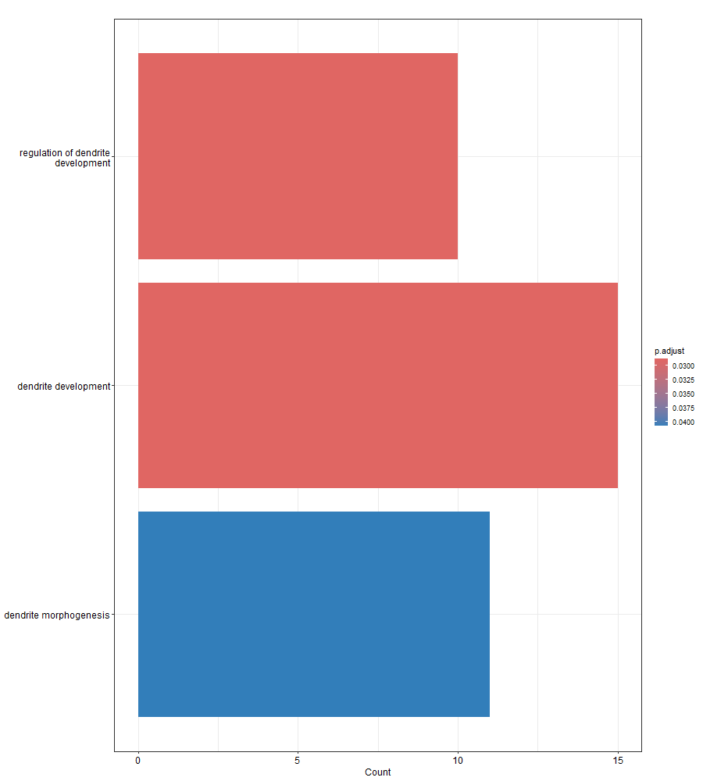
WT_SB_LOF_SB
mRNA
Upregulated genes
Downregulated genes
Notes:
Parameters:
Pval < 0.05
log2FC :
Up: log2FC > 0.25
Down: log2FC < -0.25

Slide 8
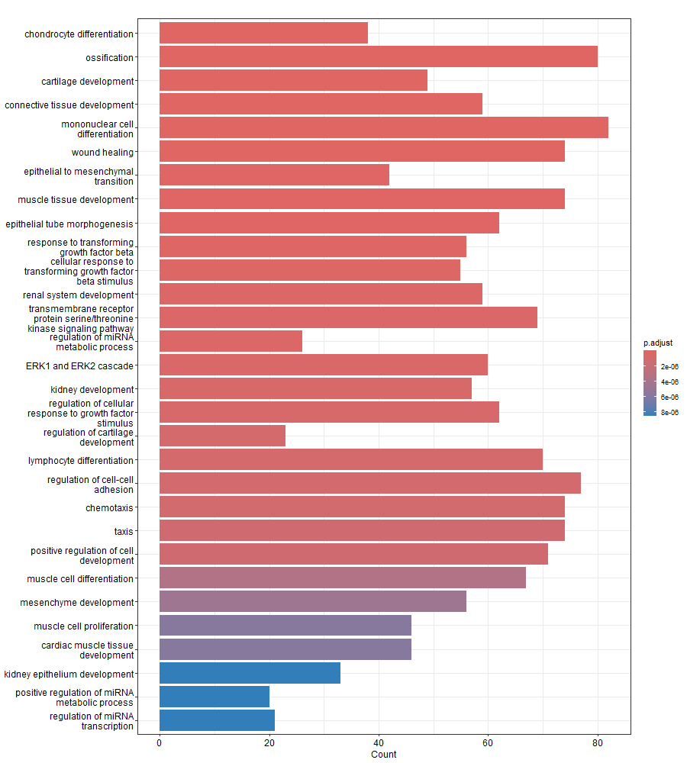
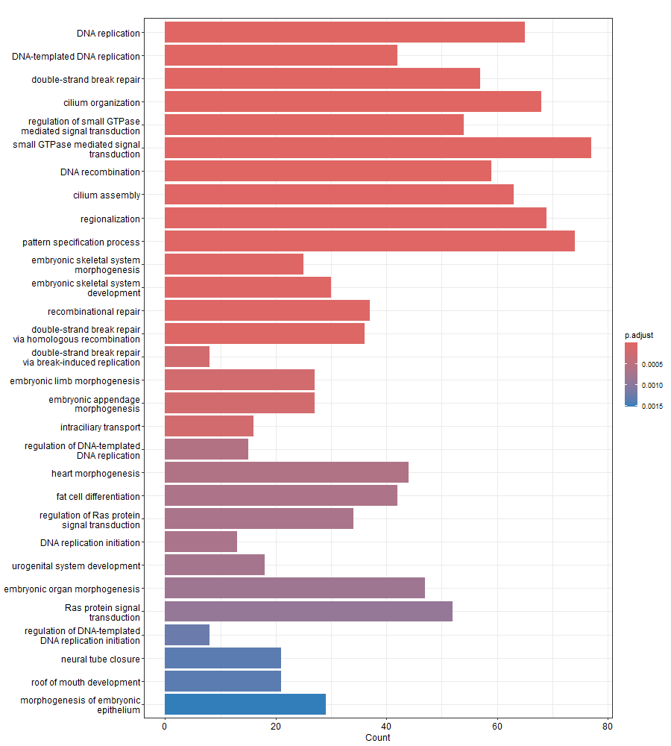
SGS_SB_SGS_TGF
mRNA
Upregulated genes
Downregulated genes
Notes:
Parameters:
Pval < 0.05
log2FC :
Up: log2FC > 0.5
Down: log2FC < -0.5

Slide 9
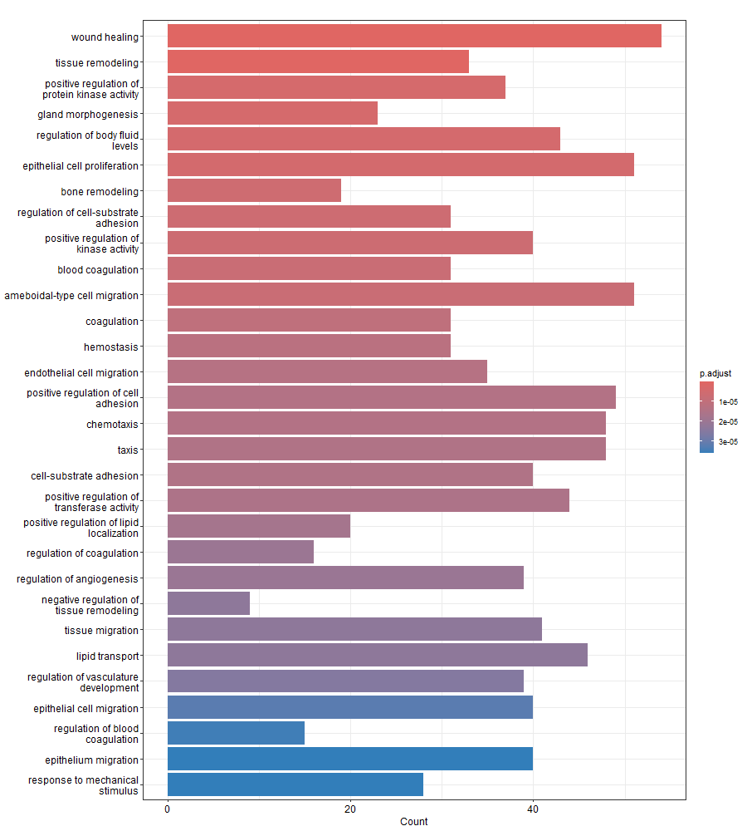
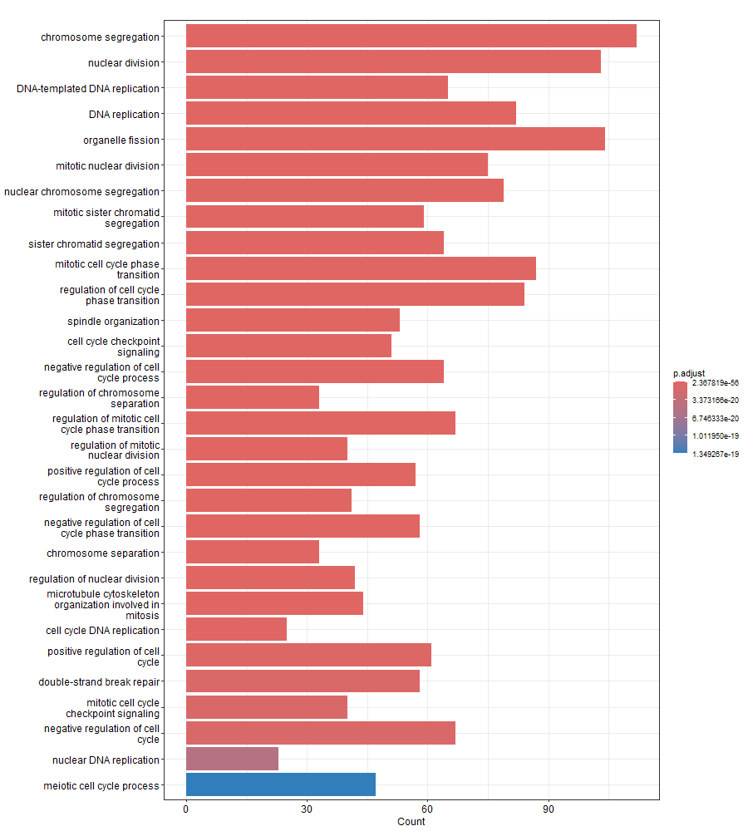
LOF_TGF_SGS_TGF
mRNA
Upregulated genes
Downregulated genes
Notes:
Parameters:
Pval < 0.05
log2FC :
Up: log2FC > 0.5
Down: log2FC < -0.5

Slide 10
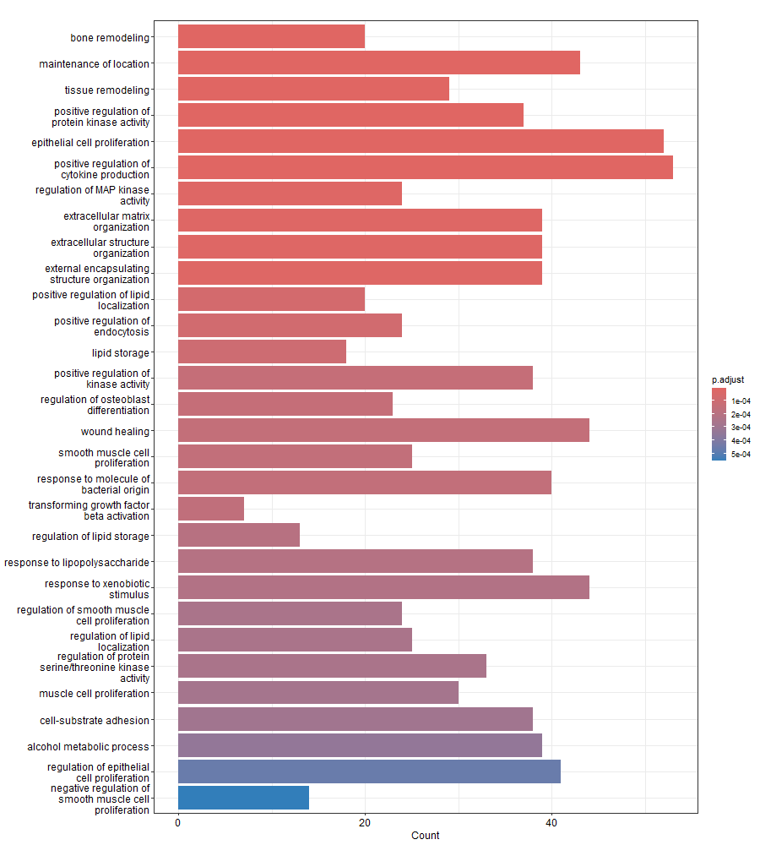
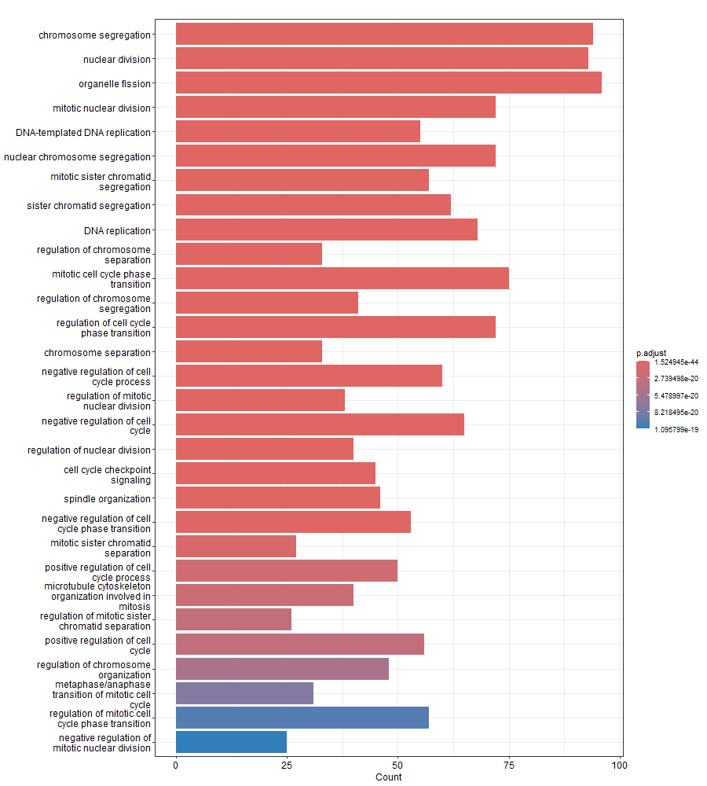
LOF_SB_SGS_SB
mRNA
Upregulated genes
Downregulated genes
Notes:
Parameters:
Pval < 0.05
log2FC :
Up: log2FC > 0.5
Down: log2FC < -0.5

Slide 11
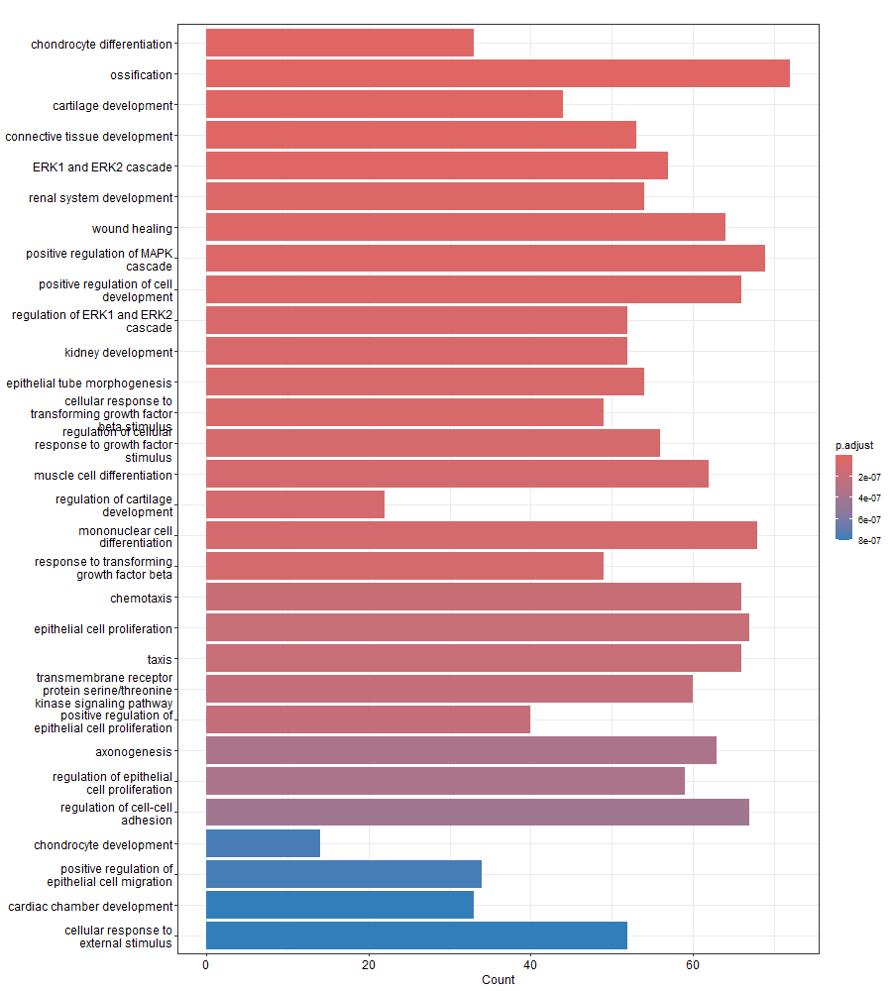
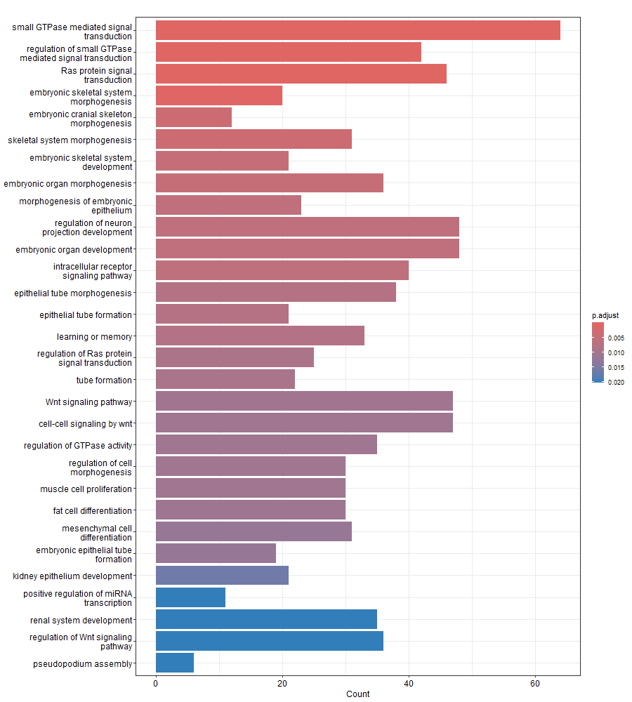
LOF_SB_LOF_TGF
mRNA
Upregulated genes
Downregulated genes
Notes:
Parameters:
Pval < 0.05
log2FC :
Up: log2FC > 0.5
Down: log2FC < -0.5

Slide 12
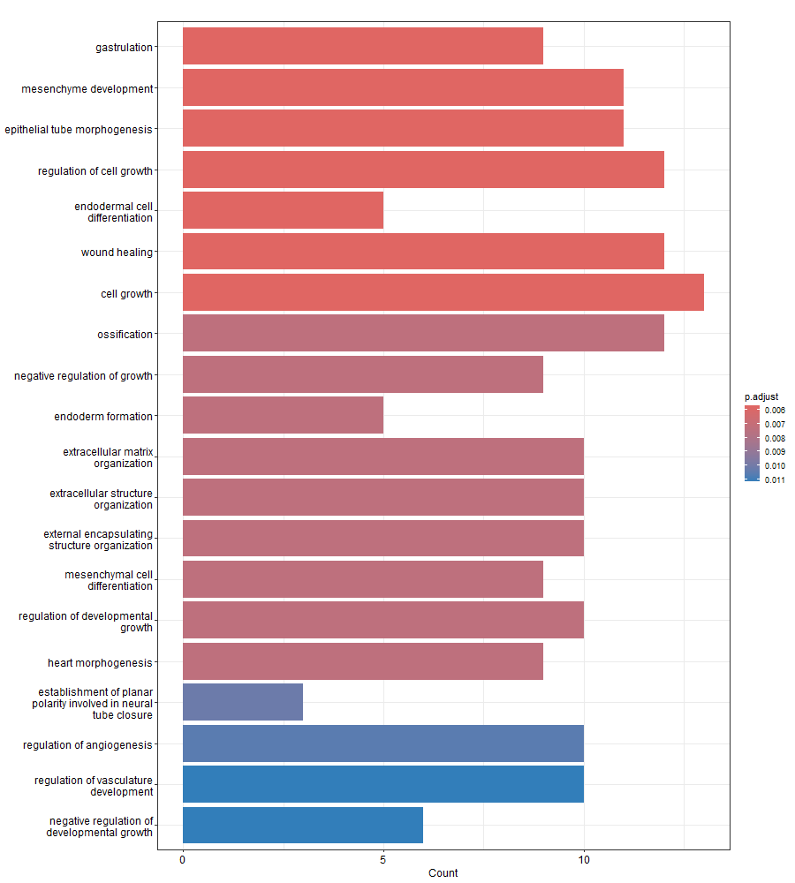
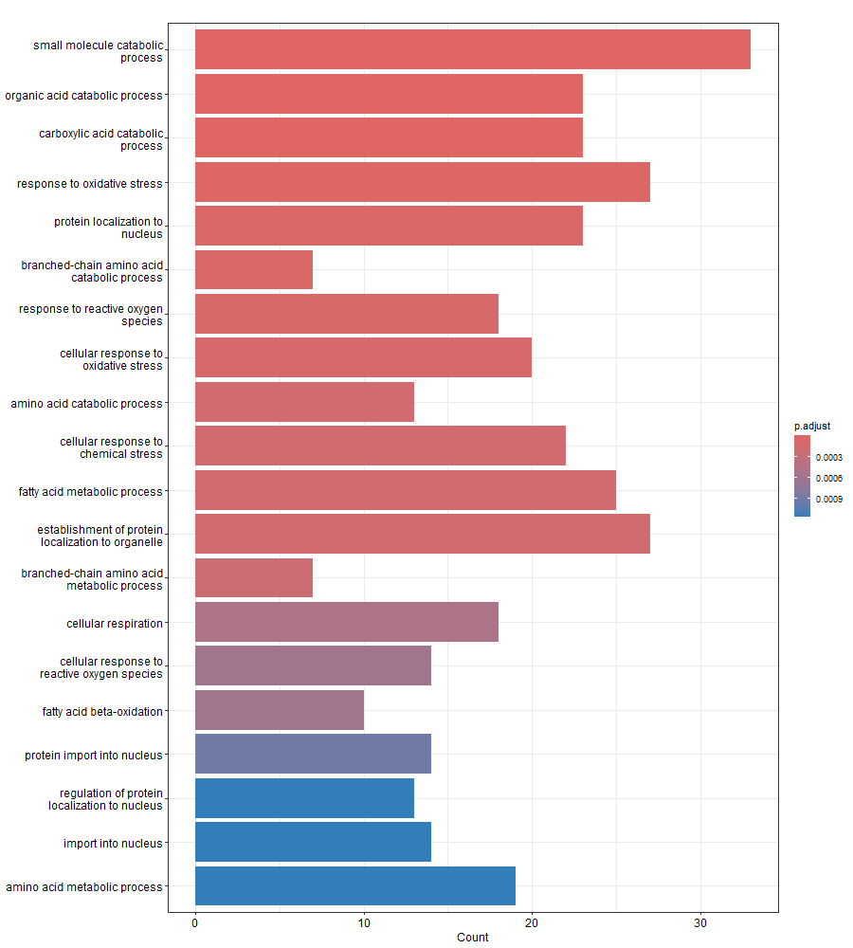
PROTEIN (TFG-β stimulation vs SB inhibition)
WT1
Upregulated genes
Downregulated genes
Notes:
Parameters:
Pval < 0.05
log2FC :
Up: log2FC > 0.5
Down: log2FC < -0.5

Slide 13
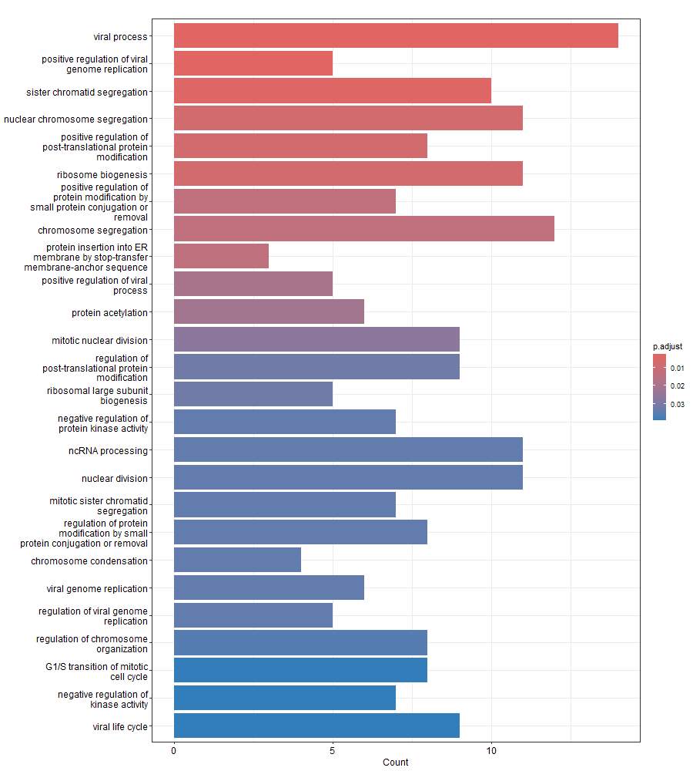
PROTEIN (TFG-β stimulation vs SB inhibition)
WT3
Upregulated genes
Downregulated genes
Upregulated genes
Notes:
Parameters:
Pval < 0.1
log2FC :
Up: log2FC > 0.
Down: log2FC < 0
Aun bajando el pval a 0,1 y log2FC > 0 (UP) o log2FC<0 (Down), no se encuentra enriquecimiento de los genes up-regulated. Mirarlo con STRING.

Slide 14
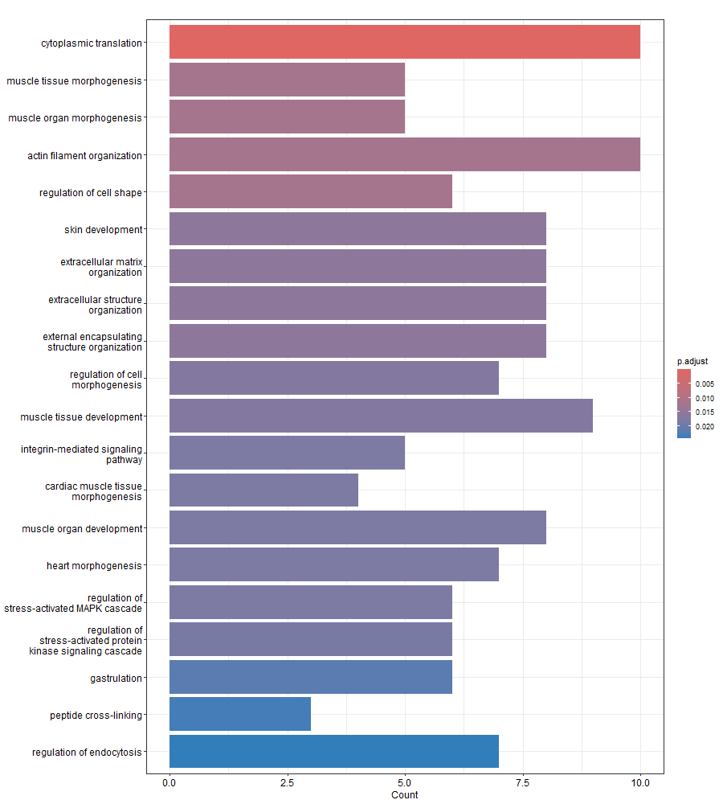
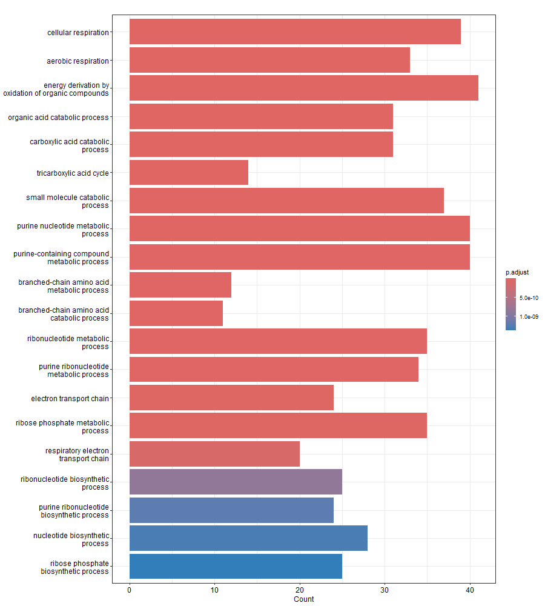
PROTEIN (TFG-β stimulation vs SB inhibition)
WT4
Upregulated genes
Downregulated genes
Notes:
Parameters:
Pval < 0.1
log2FC :
Up: log2FC > 0
Down: log2FC < 0

Slide 15
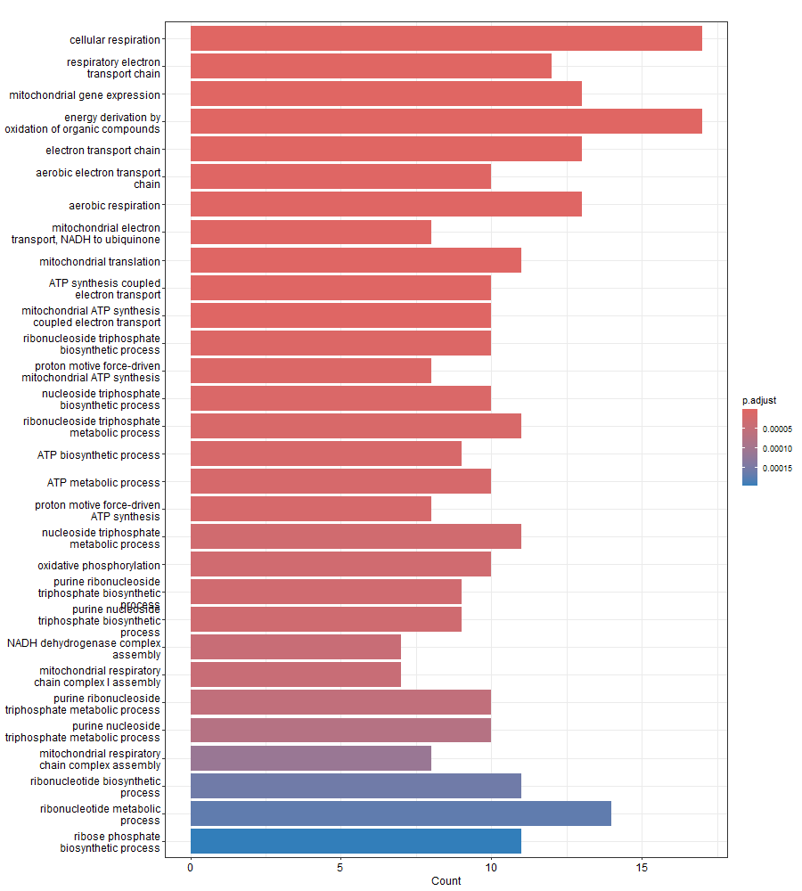
PROTEIN (TFG-β stimulation vs SB inhibition)
WT (1,3,4)
Upregulated genes
Downregulated genes
Notes:
Parameters:
Pval < 0.1
log2FC :
Up: log2FC > 0
Down: log2FC < 0
Aun bajando el pval a 0,1 y log2FC > 0 (UP) o log2FC<0 (Down), no se encuentra enriquecimiento de los genes up-regulated. Mirarlo con STRING.

Slide 16
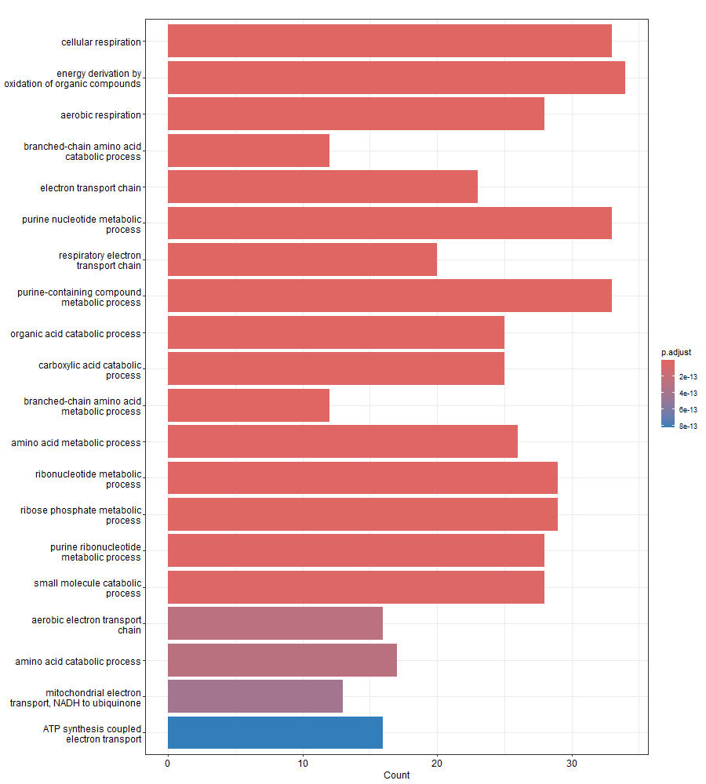
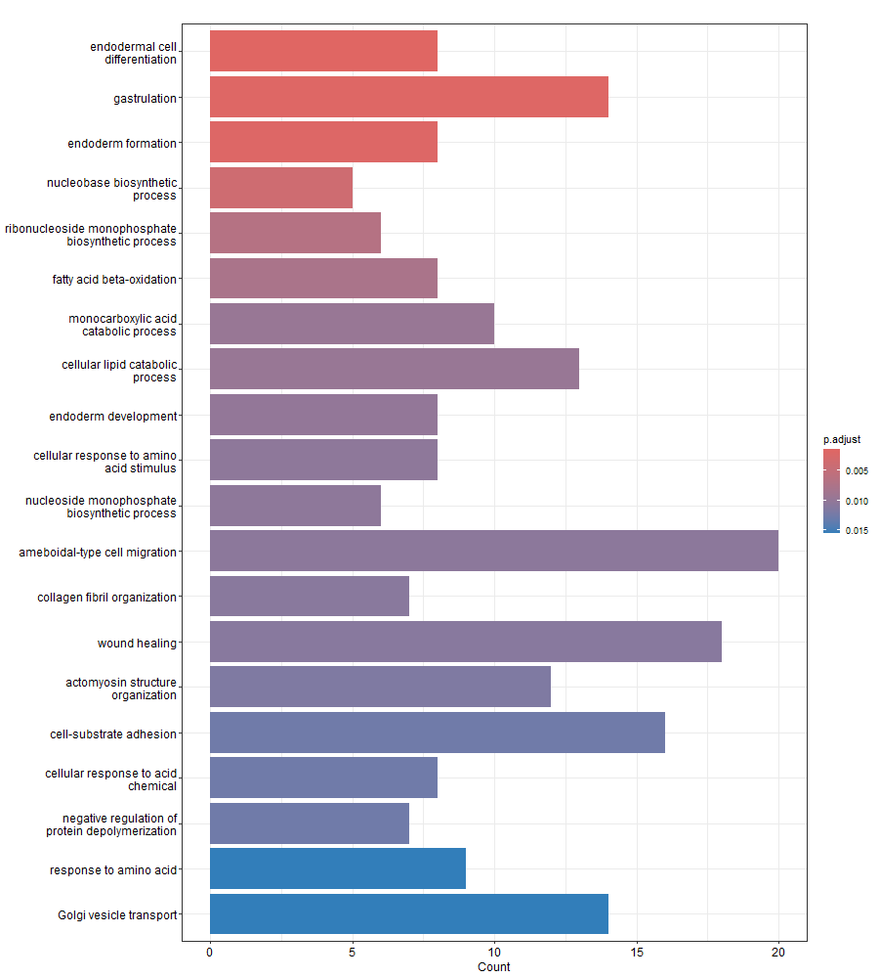
PROTEIN (TFG-β stimulation vs SB inhibition)
SGS2
Upregulated genes
Downregulated genes
Notes:
Parameters:
Pval < 0.05
log2FC :
Up: log2FC > 0.5
Down: log2FC < -0.5

Slide 17
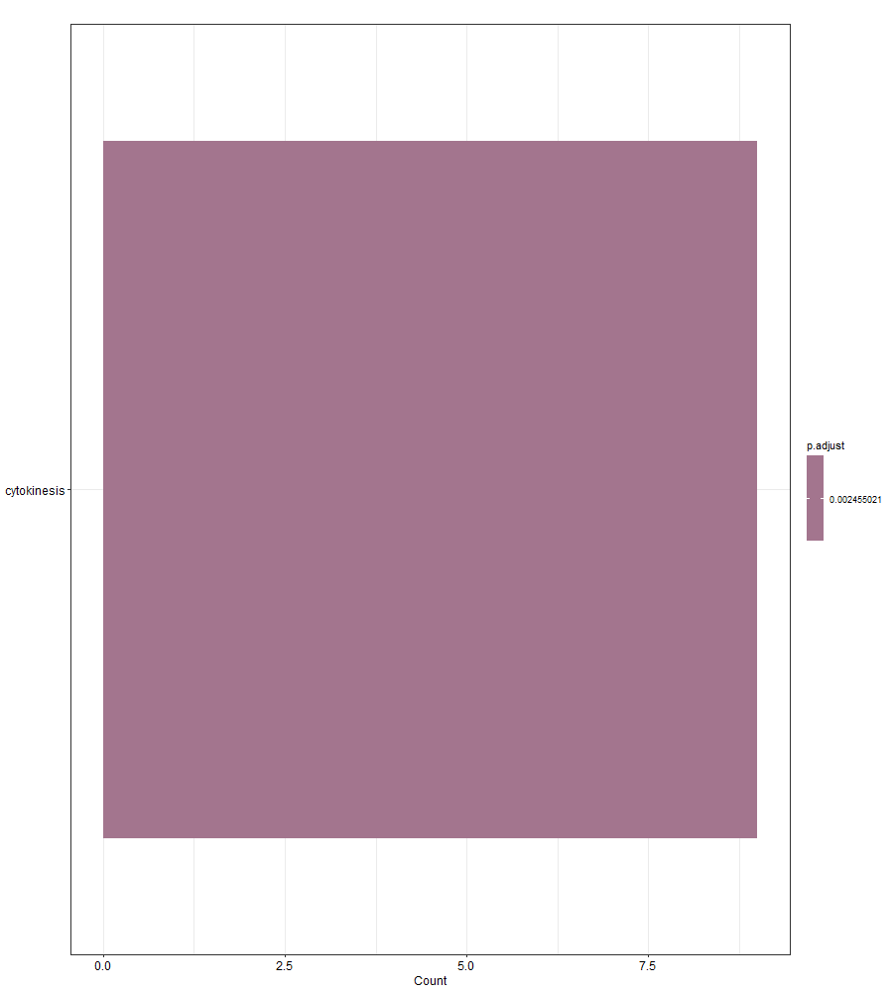
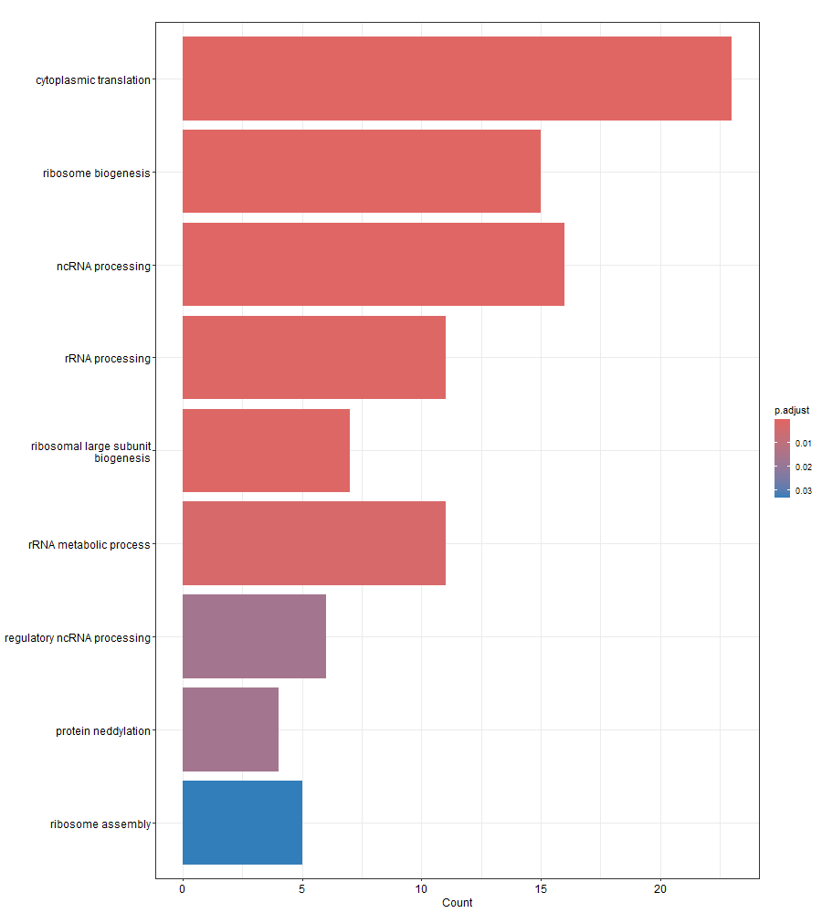
PROTEIN (TFG-β stimulation vs SB inhibition)
SGS3
Upregulated genes
Downregulated genes
Notes:
Parameters:
Pval < 0.1
log2FC :
Up: log2FC > 0
Down: log2FC < 0

Slide 18
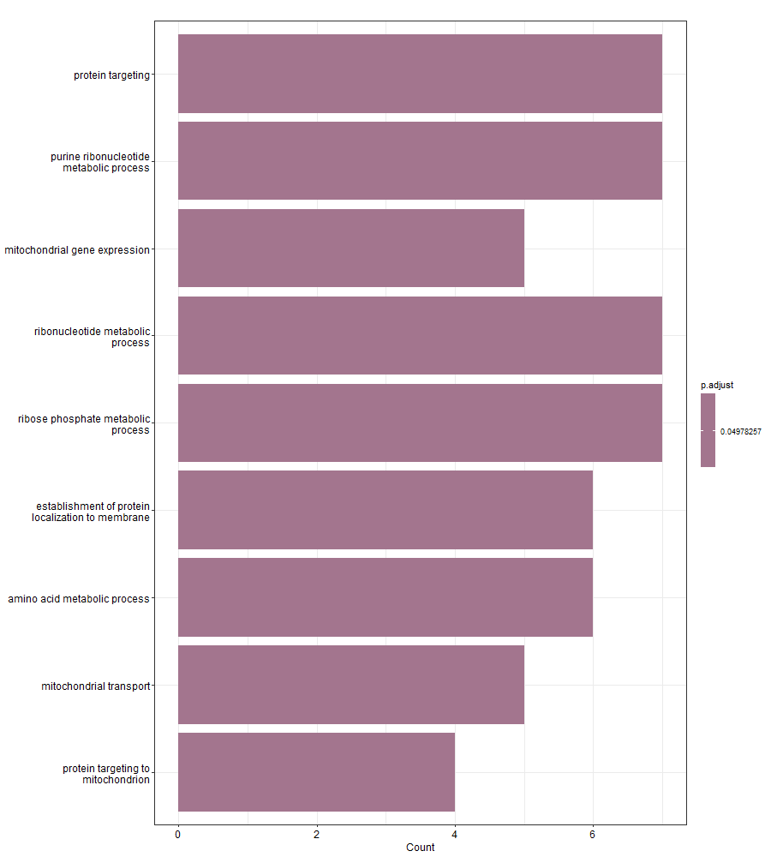
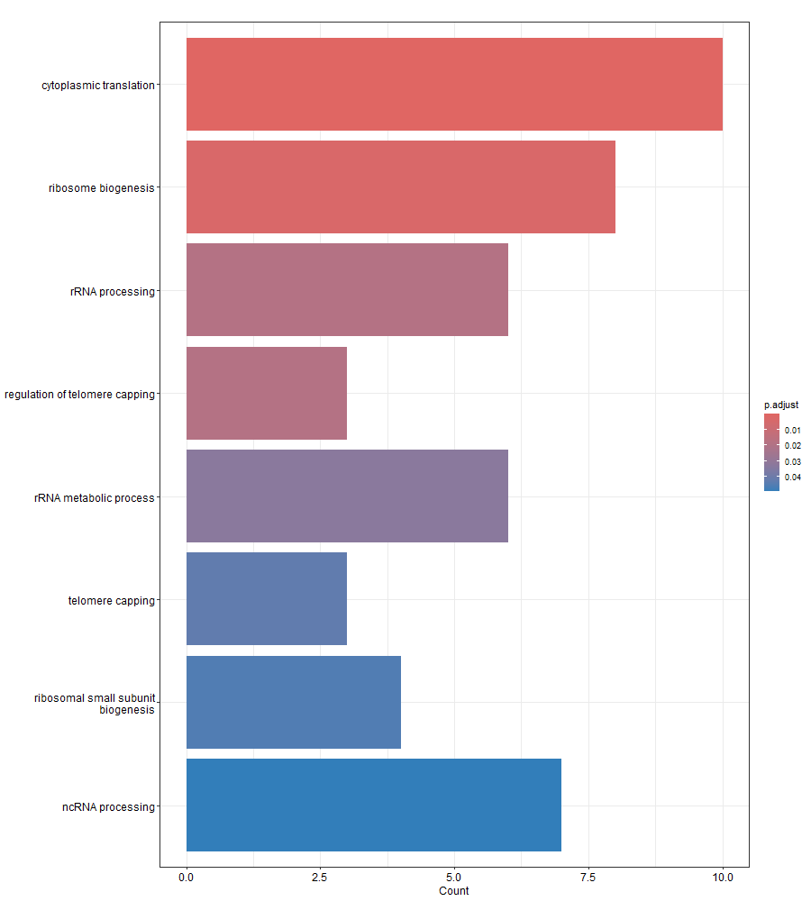
PROTEIN (TFG-β stimulation vs SB inhibition)
SGS (2,3)
Upregulated genes
Downregulated genes
Notes:
Parameters:
Pval < 0.05
log2FC :
Up: log2FC > 0.25
Down: log2FC < -0.25

Slide 19
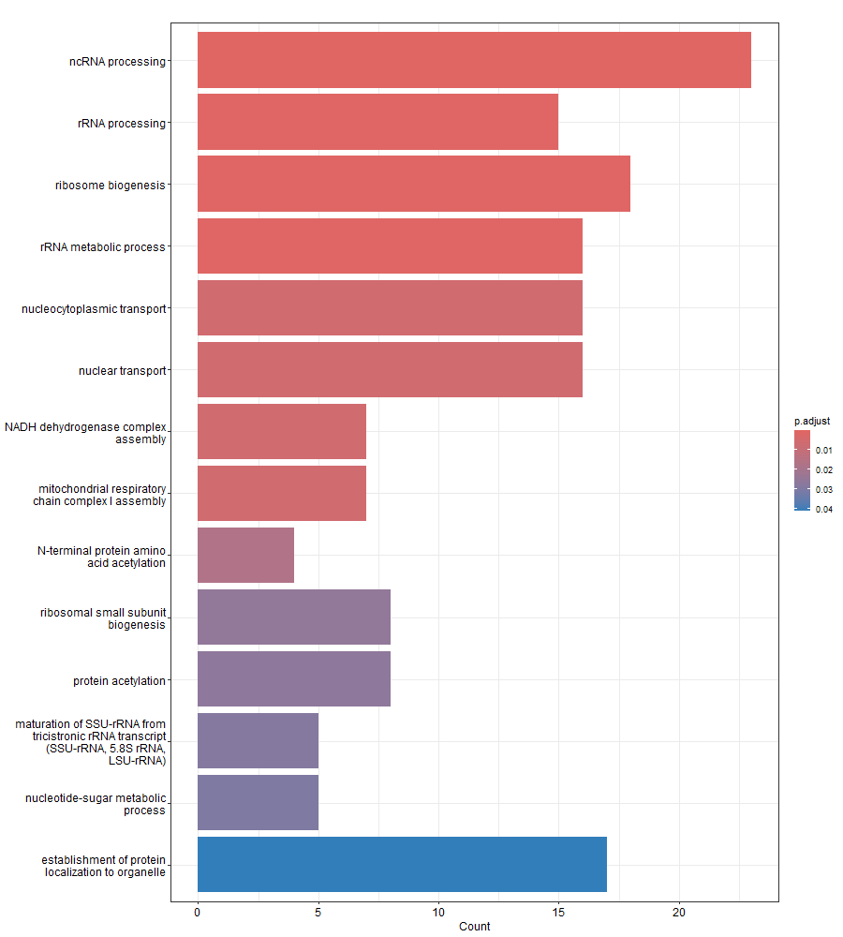
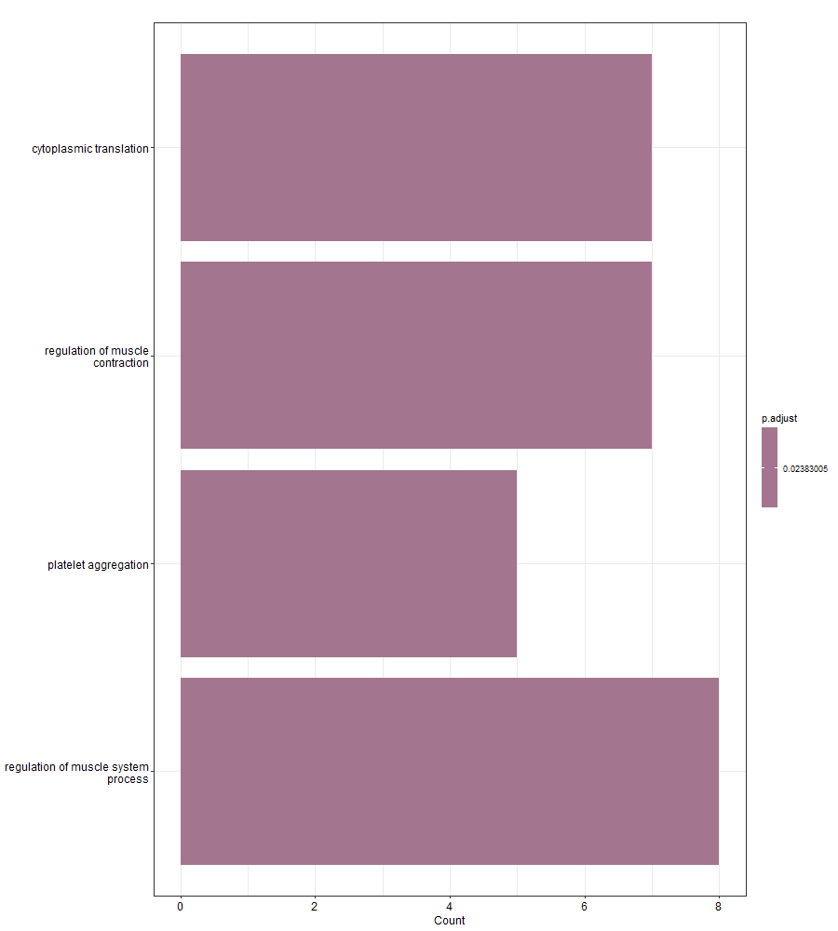
PROTEIN (TFG-β stimulation vs SB inhibition)
LOF1
Upregulated genes
Downregulated genes
Notes:
Parameters:
Pval < 0.1
log2FC :
Up: log2FC > 0.25
Down: log2FC < -0.25

Slide 20
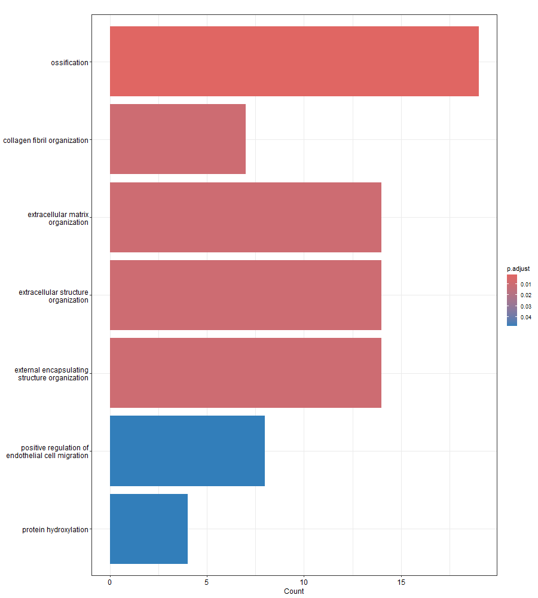
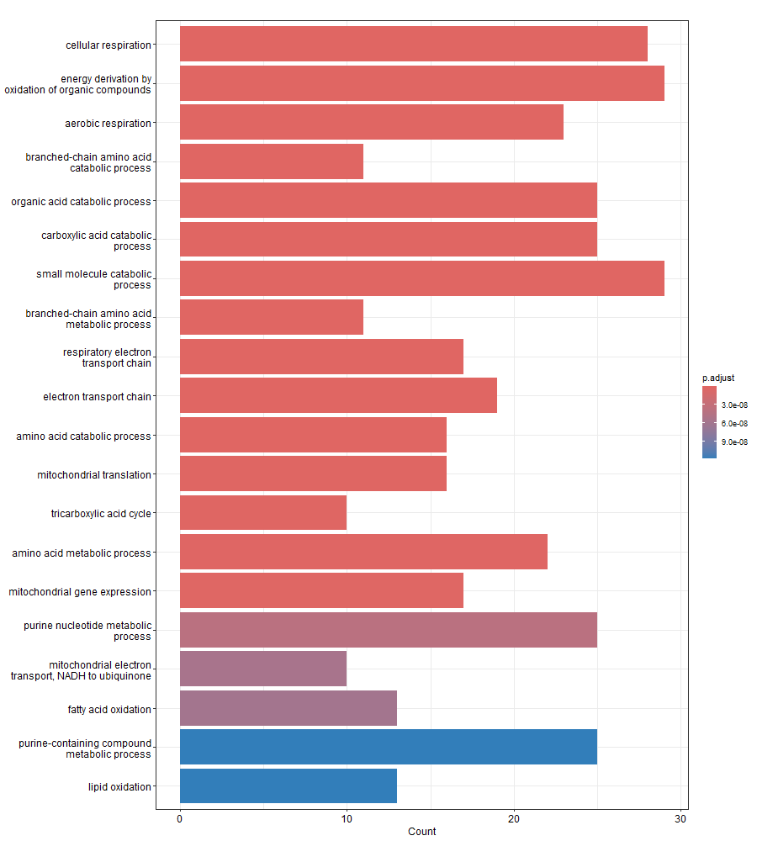
PROTEIN (TFG-β stimulation vs SB inhibition)
LOF2
Upregulated genes
Downregulated genes
Notes:
Parameters:
Pval < 0.05
log2FC :
Up: log2FC > 0.5
Down: log2FC < -0.5

Slide 21
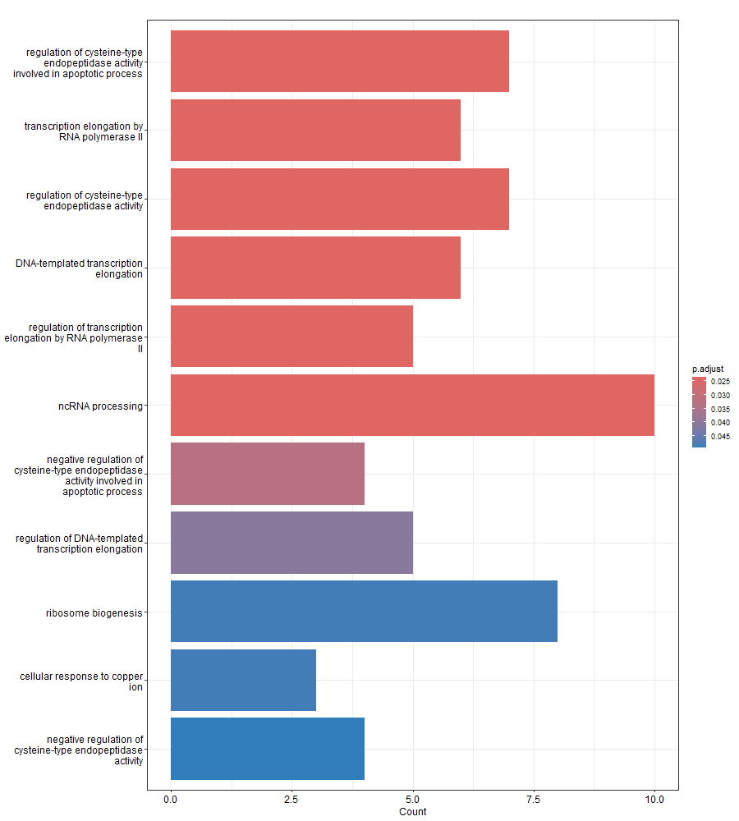
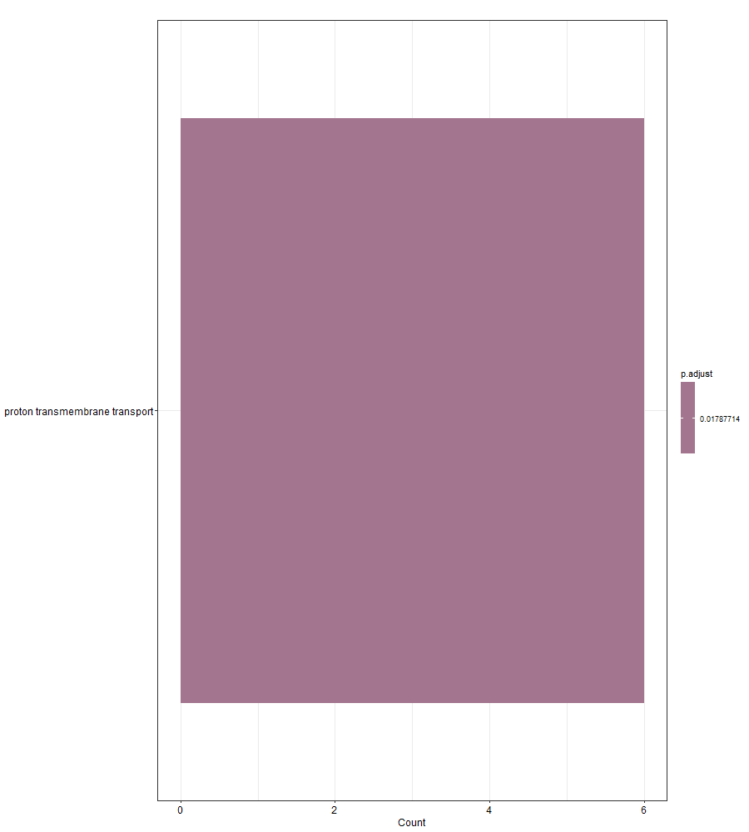
PROTEIN (TFG-β stimulation vs SB inhibition)
LOF (1,2)
Upregulated genes
Downregulated genes
Notes:
Parameters:
Pval < 0.1
log2FC :
Up: log2FC > 0
Down: log2FC < 0

Slide 22
STRING NETWORKS ANALYSIS
R packages used:
clusterProfiler: version 4.10.1
AnnotationDbi : version 1.64.1
org.Hs.eg.db : version 3.18.0
readxl : version 1.4.3
reshape2 : version 1.4.4
STRINGdb : version 2.14.3
tidyverse : version 2.0.0
Software used:
R: version 4.3.3
Cytoscape: versión 3.10.2
Cytoscape apps used:
EnrichGO
Enrichment Map
autoAnnotate
ClueGO – CluePedia Bio-Proccess

Slide 23
Añadir: - redes de genes – clusters de pathways huevos de pascua pintados (Enrichment Map + autoAnnotate) – algún diagrama clueGO (más ilustrativo)
mRNA & proteína
Combinaciones:
WT – LOF
WT – SGS
(Comparación directa SGS – LOF y LOF – SGS) ****
WT SB – TGFb
LOF SB – TGFb
SGS SB - TGFb

Slide 24
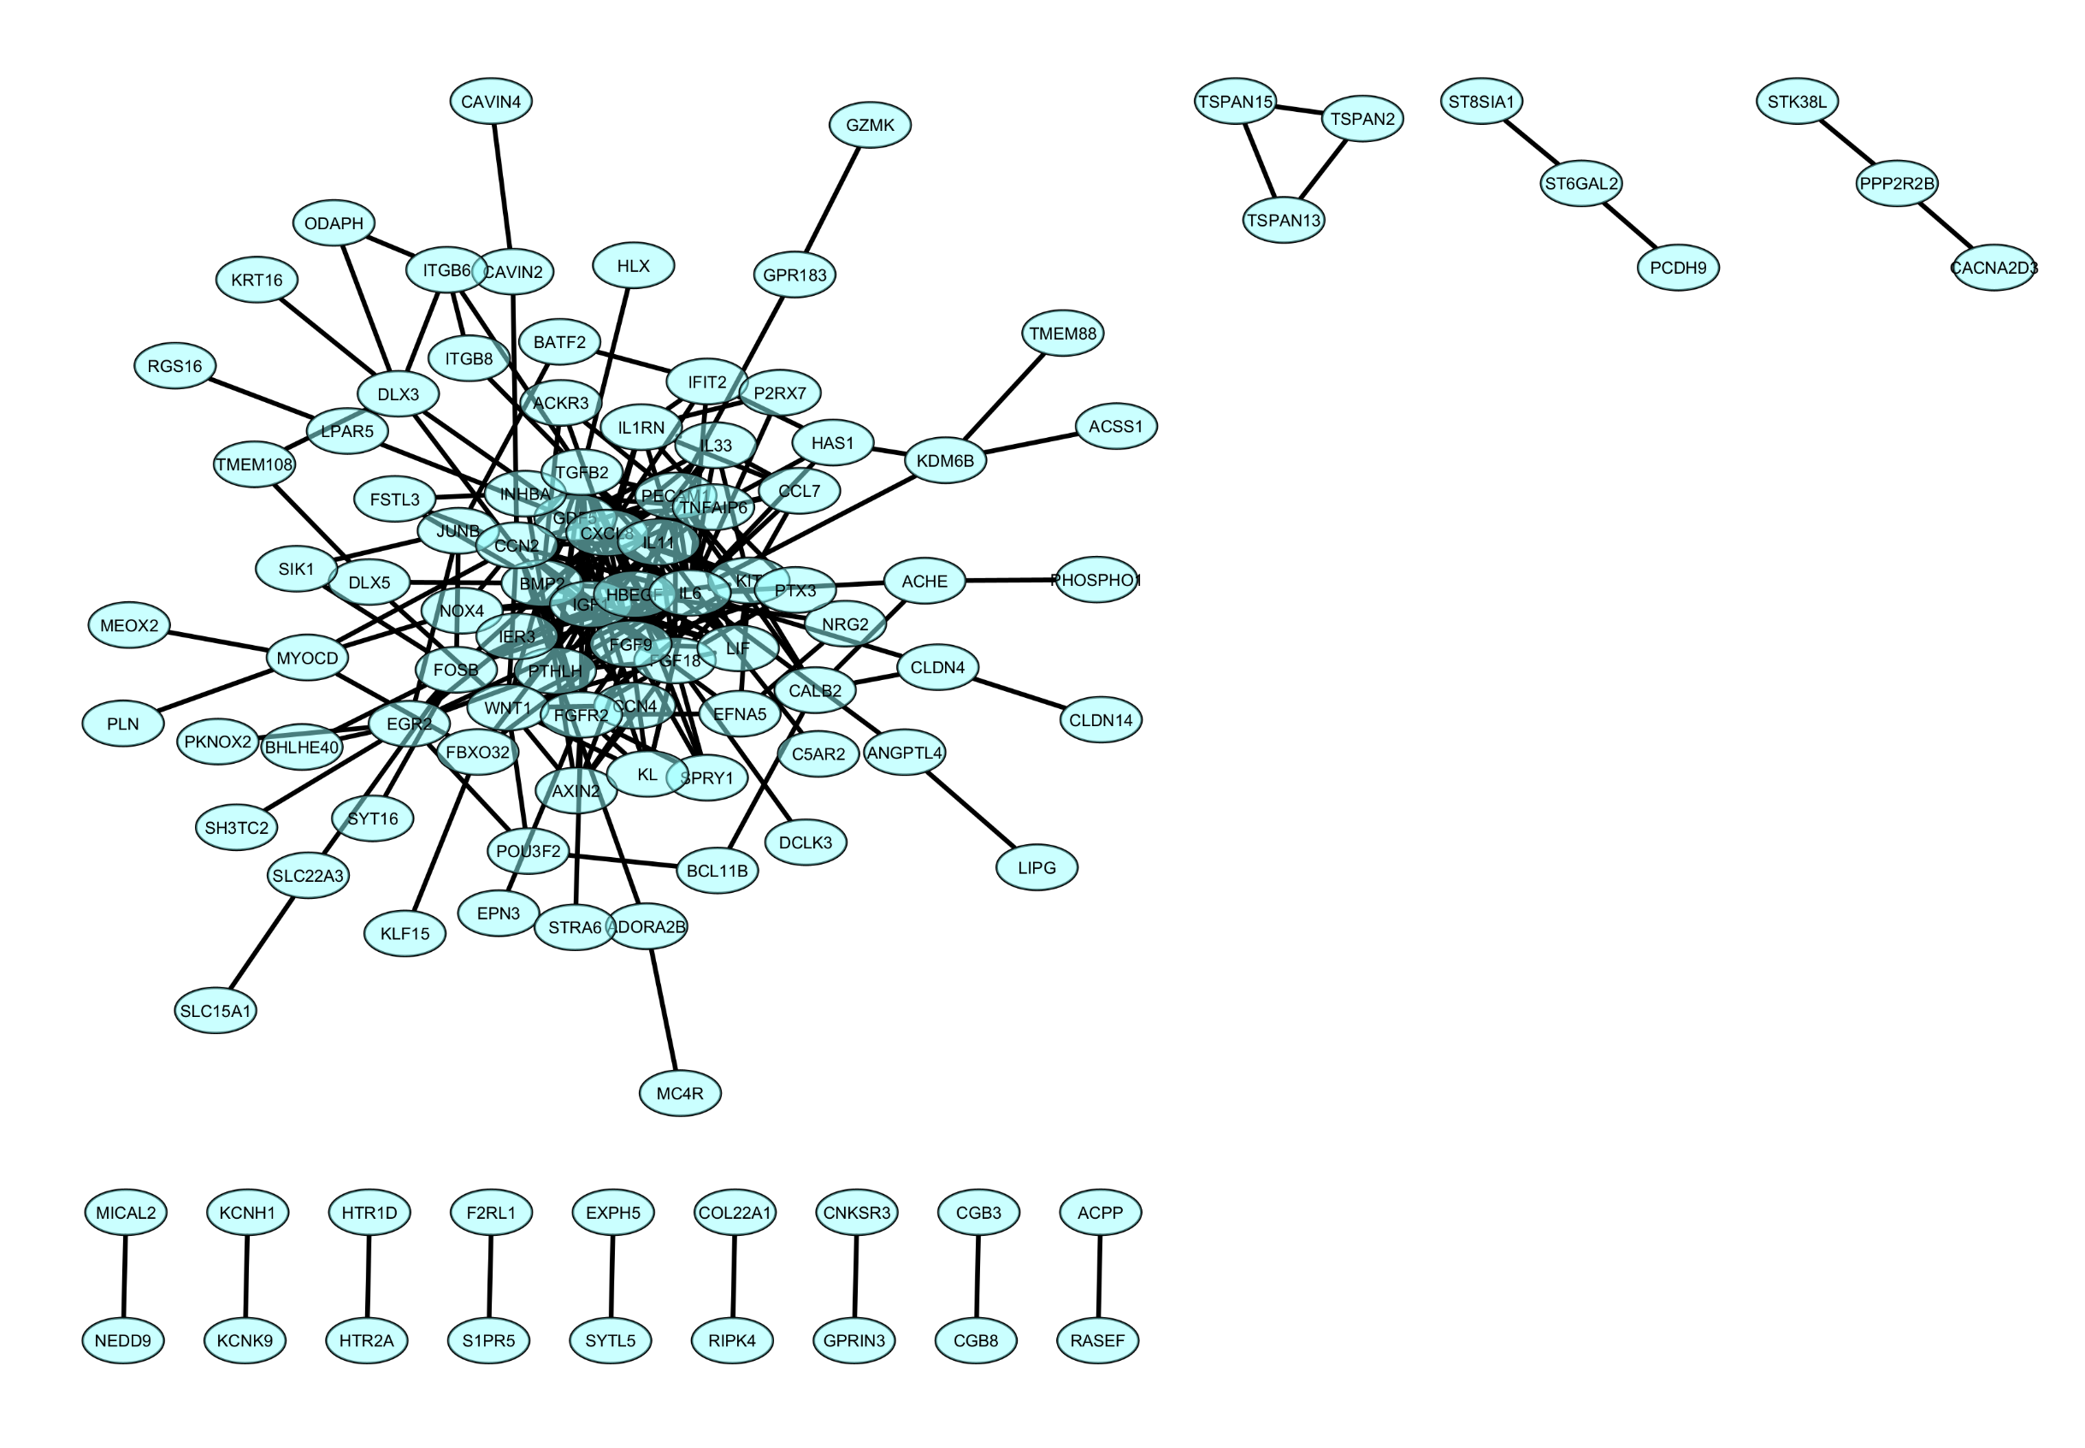
WT-SB vs WT-TGFB
mRNA
Fuente: STRING Network from Cytoscape, version 3.10.2

Slide 25
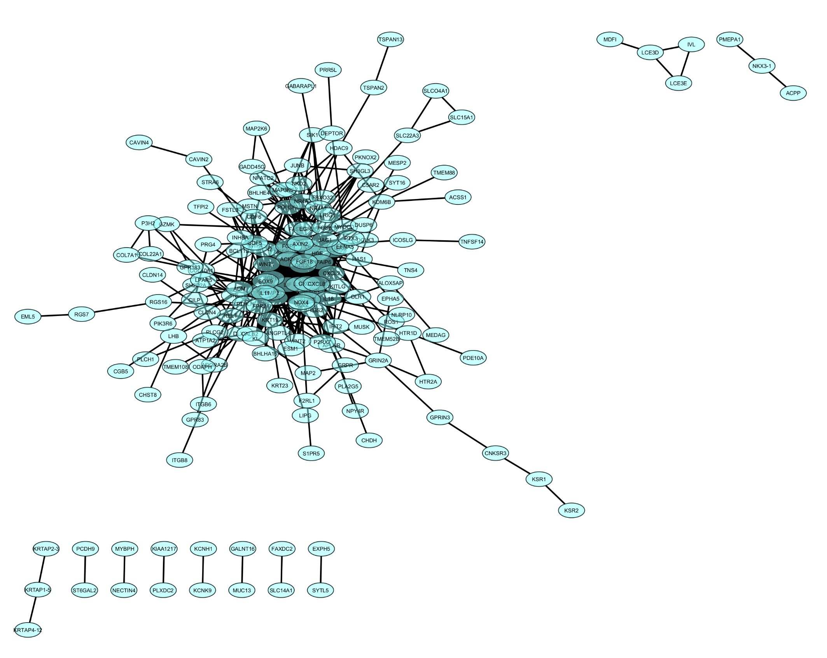
LOF-SB vs LOF-TGFB
mRNA
Fuente: STRING Network from Cytoscape, version 3.10.2

Slide 26
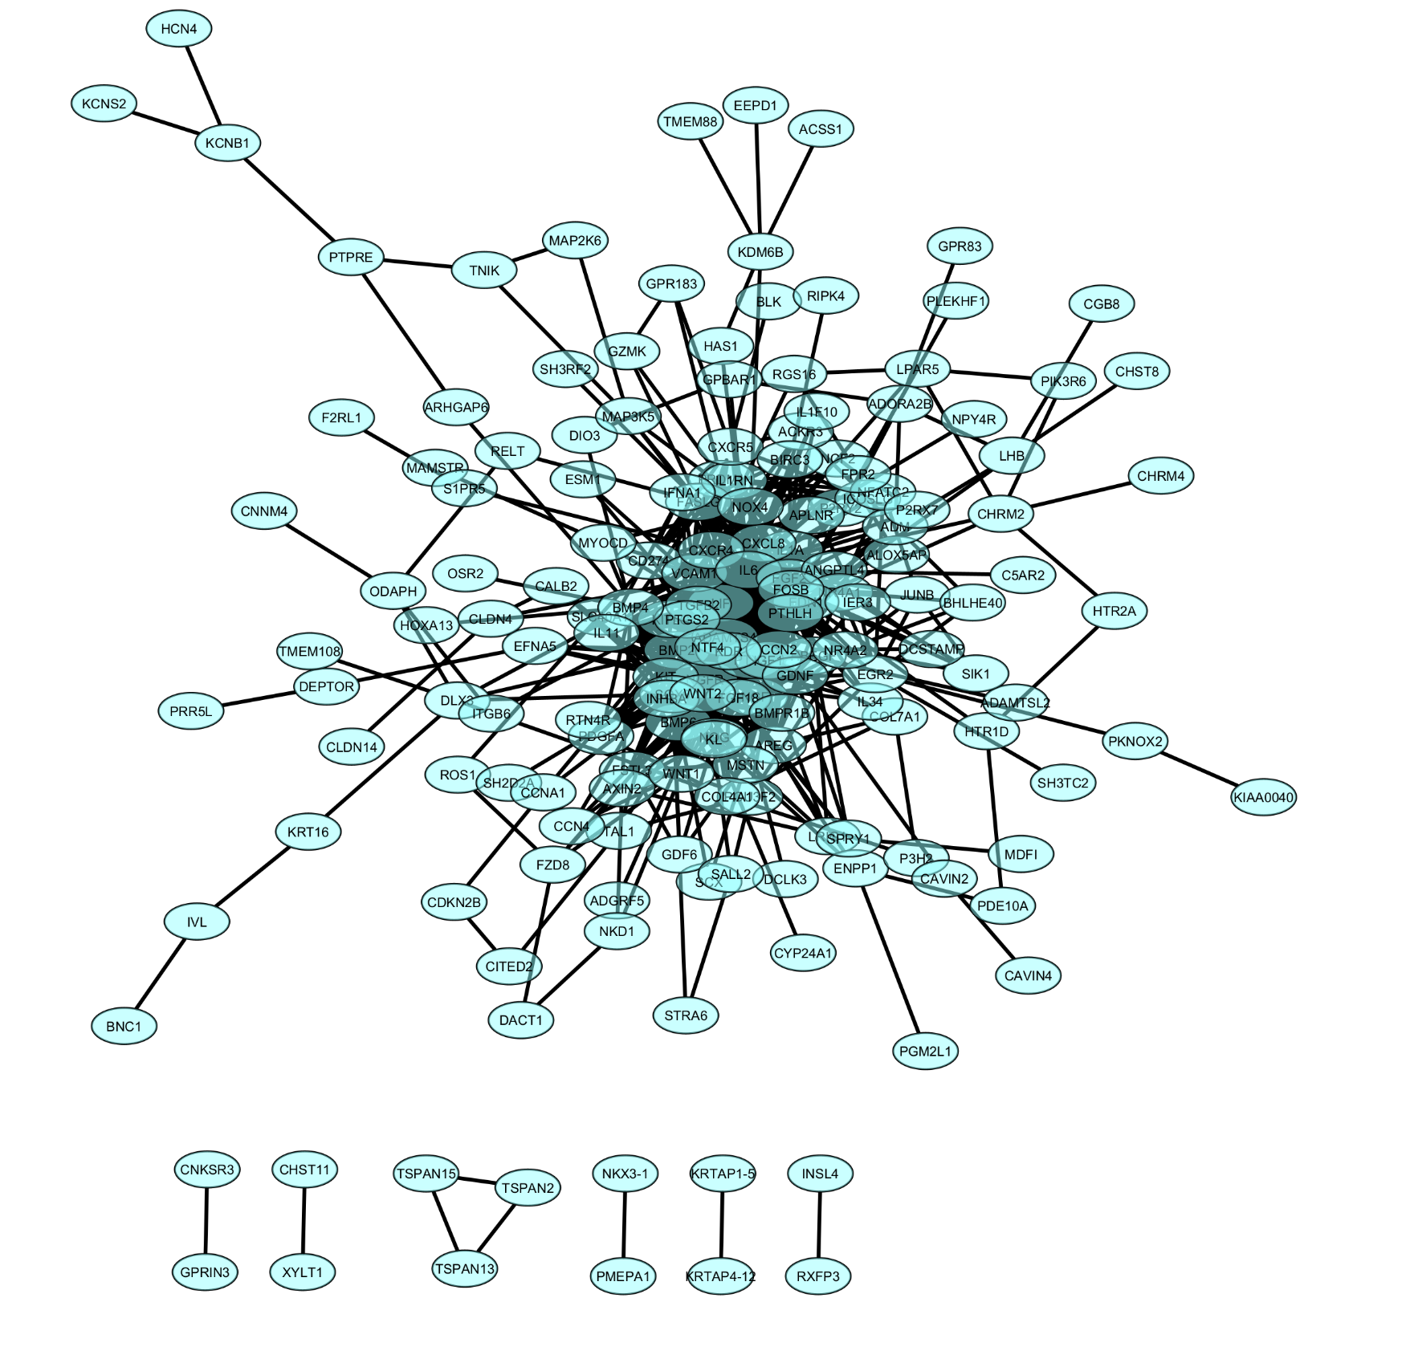
SGS-SB vs SGS-TGFB
mRNA
Fuente: STRING Network from Cytoscape, version 3.10.2

Slide 27
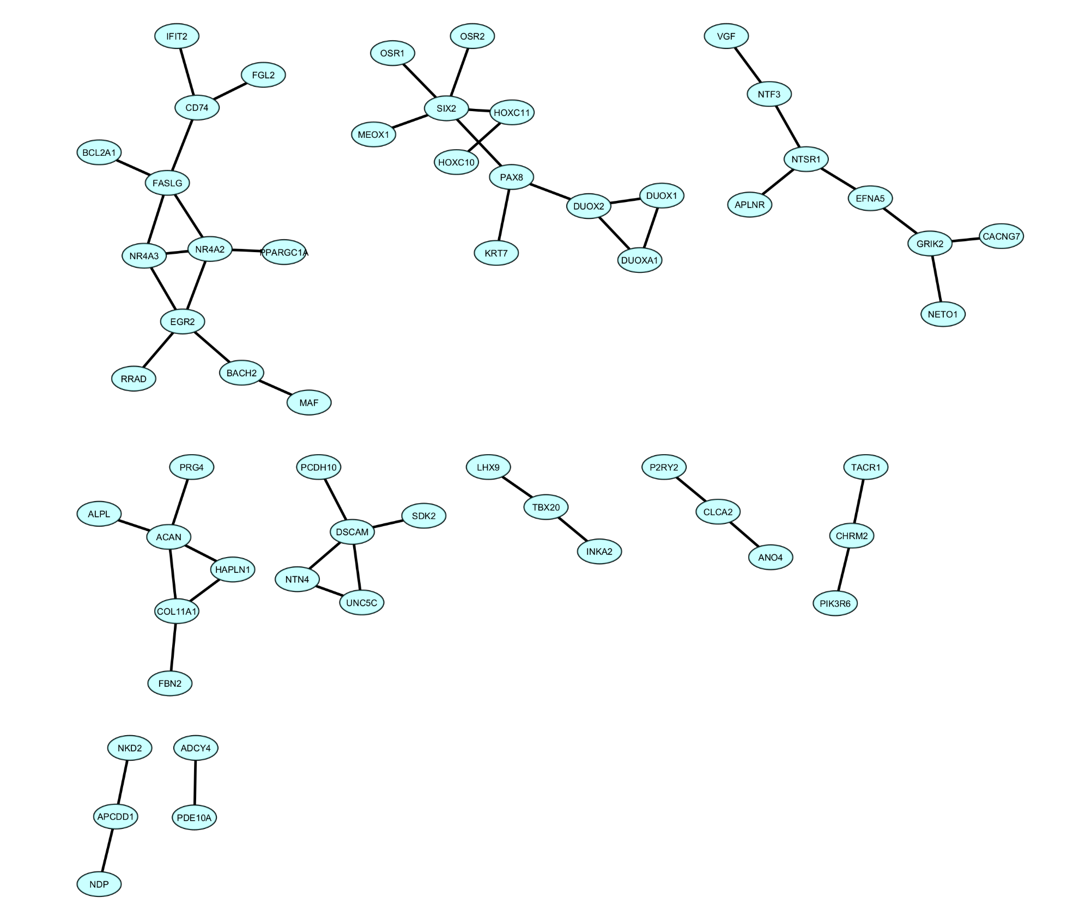
WT_TGFB – LOF_TGFB
mRNA
Fuente: STRING Network from Cytoscape, version 3.10.2

Slide 28
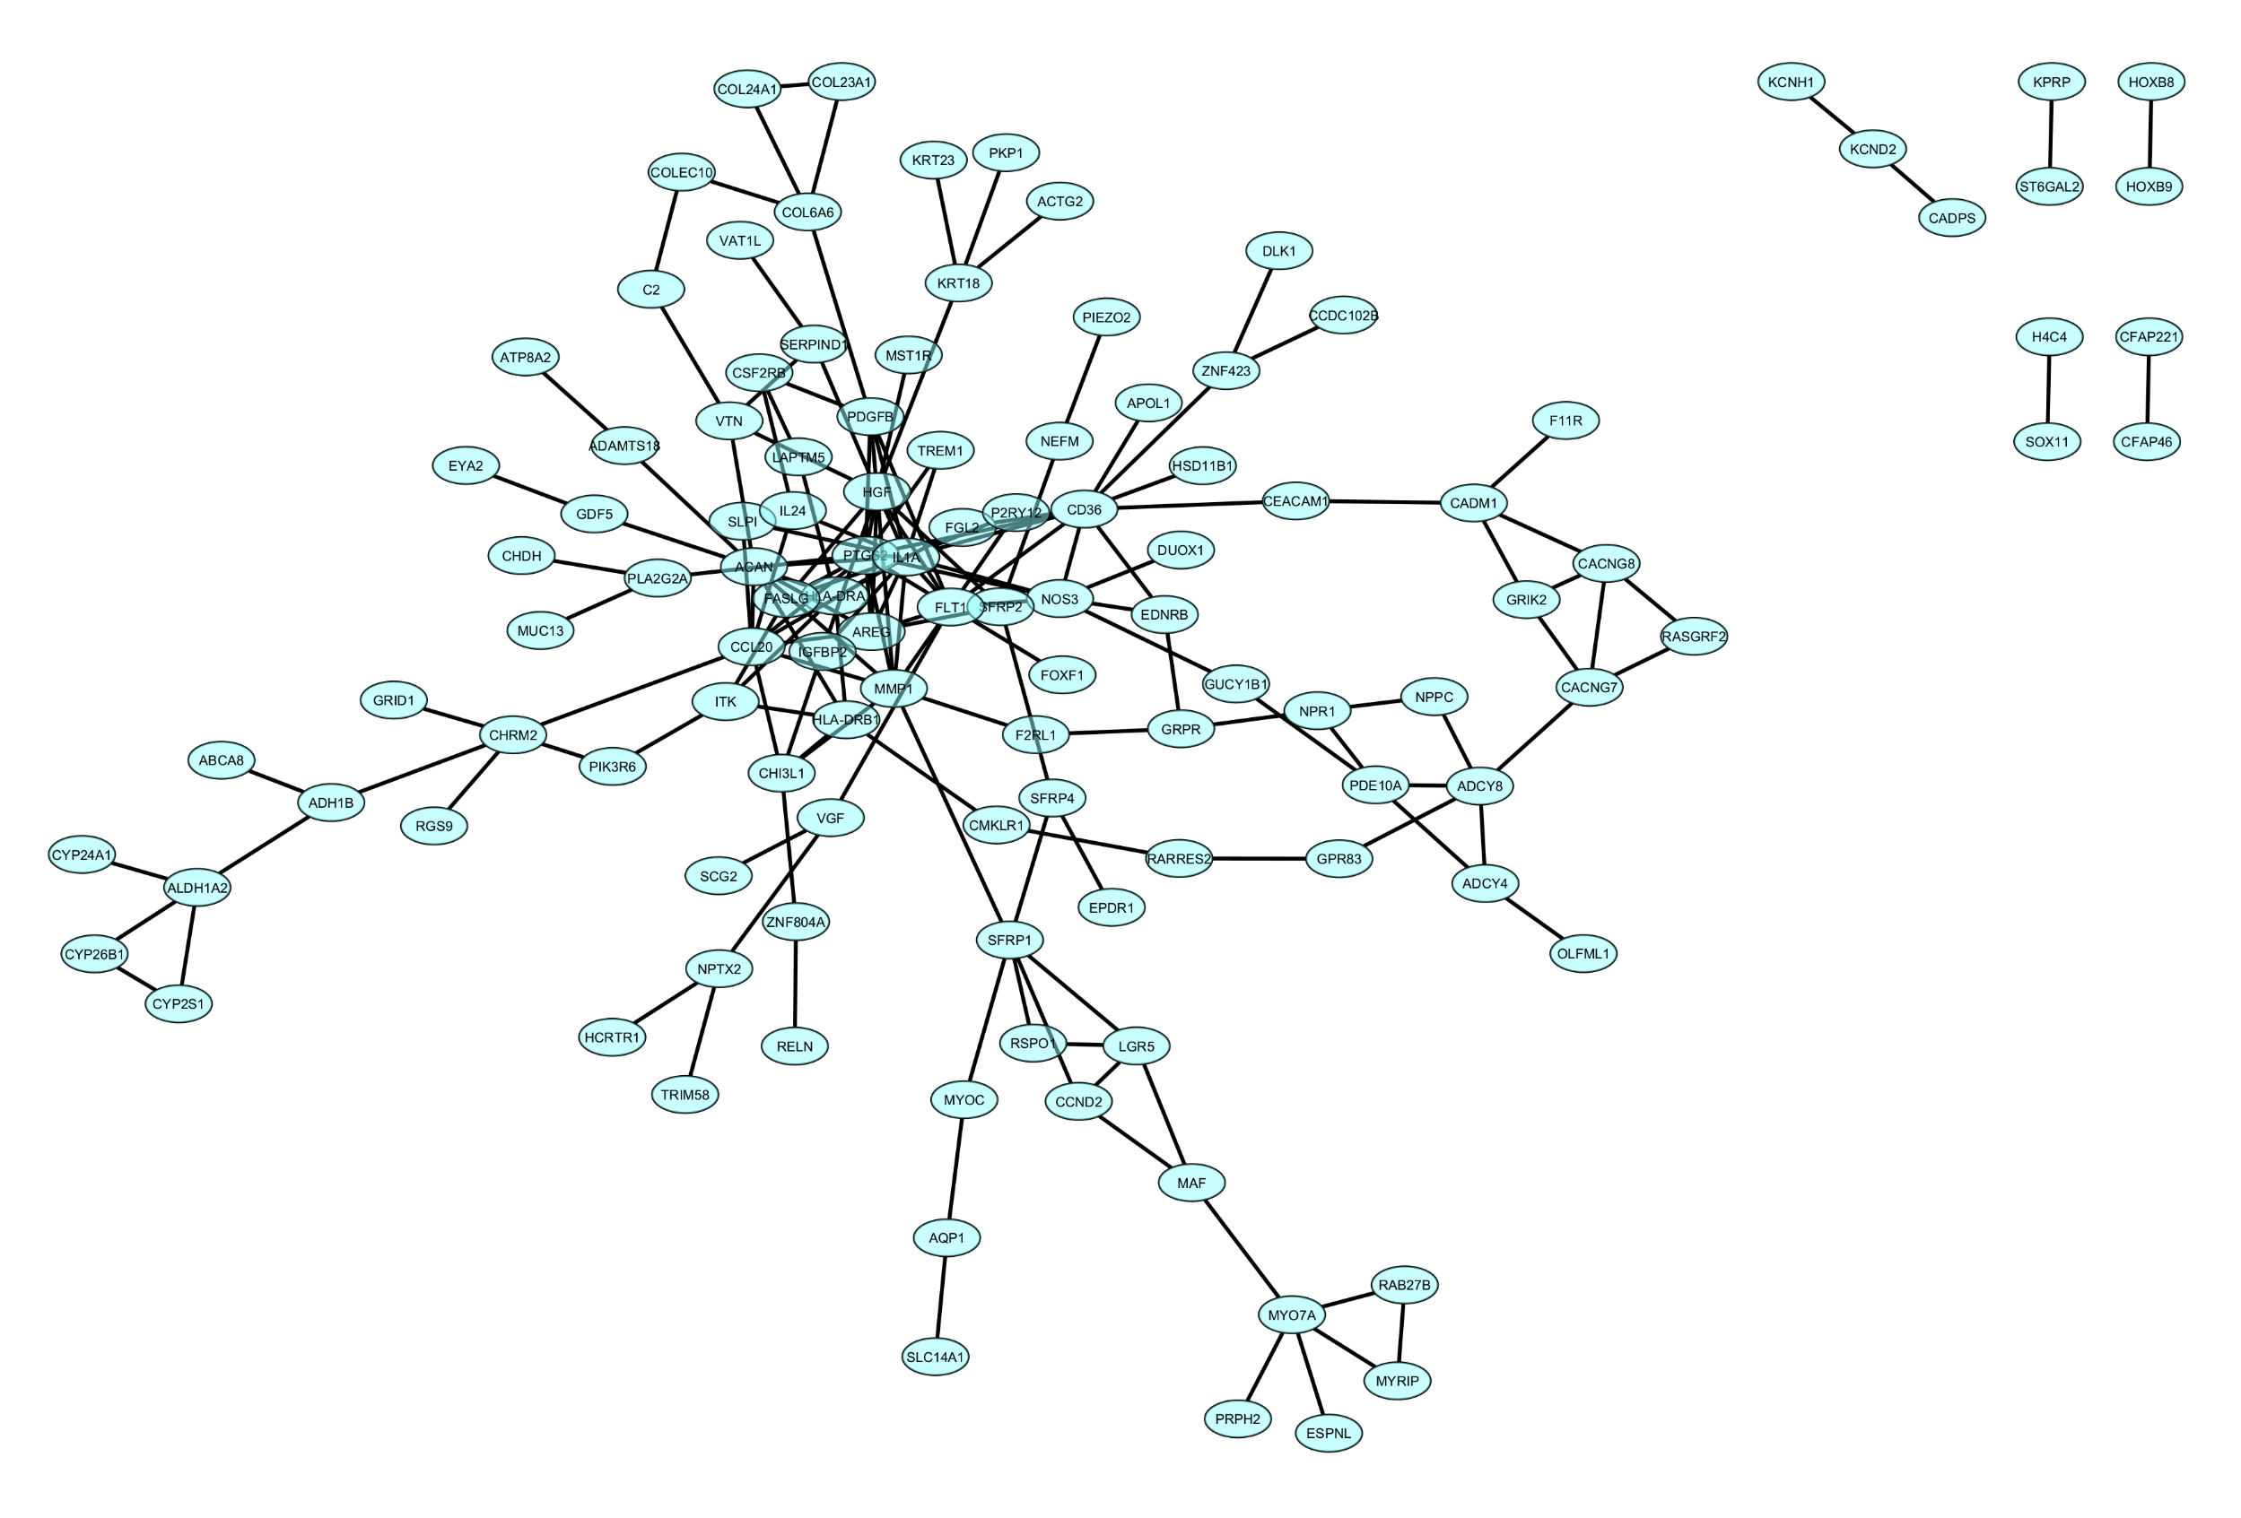
WT_TGFB - SGS_TGFB
mRNA
Fuente: STRING Network from Cytoscape, version 3.10.2

Slide 29
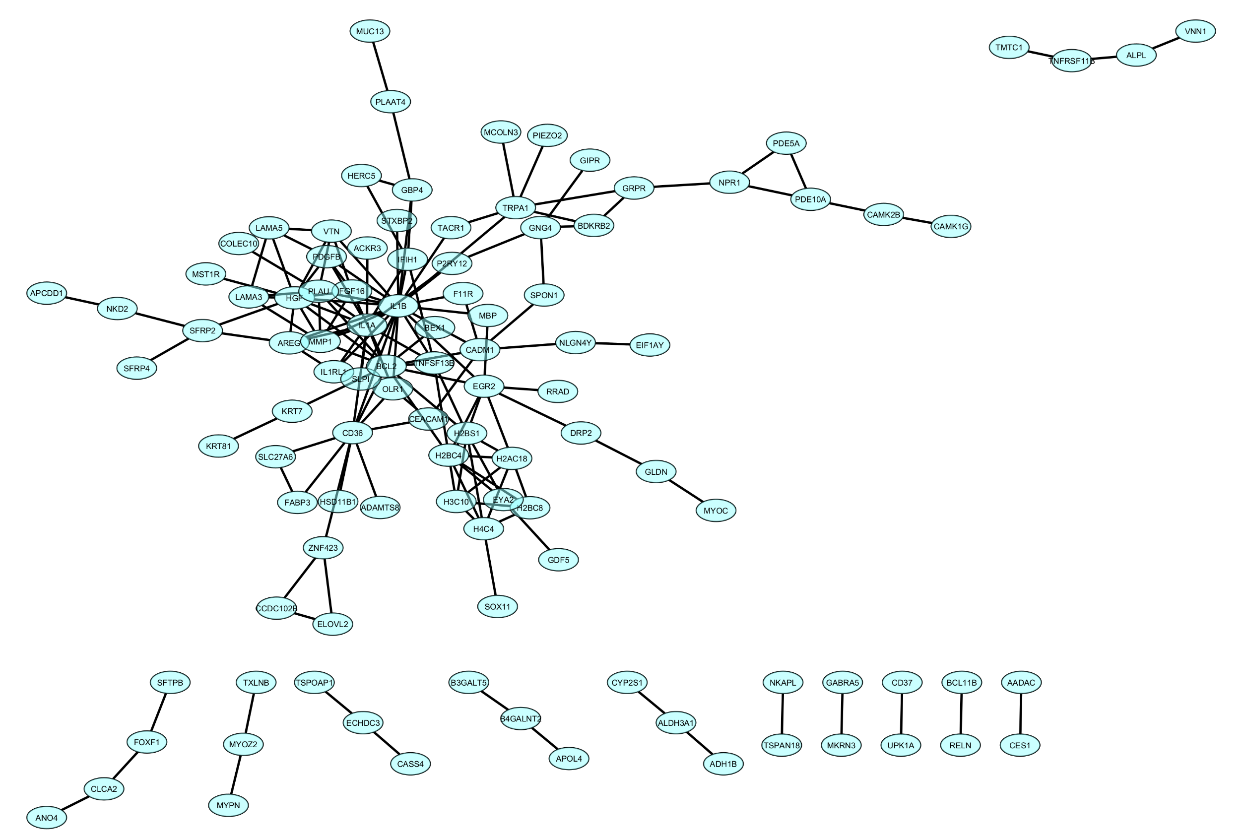
SGS_TGFB – LOF_TGFB
mRNA
Fuente: STRING Network from Cytoscape, version 3.10.2

Slide 30
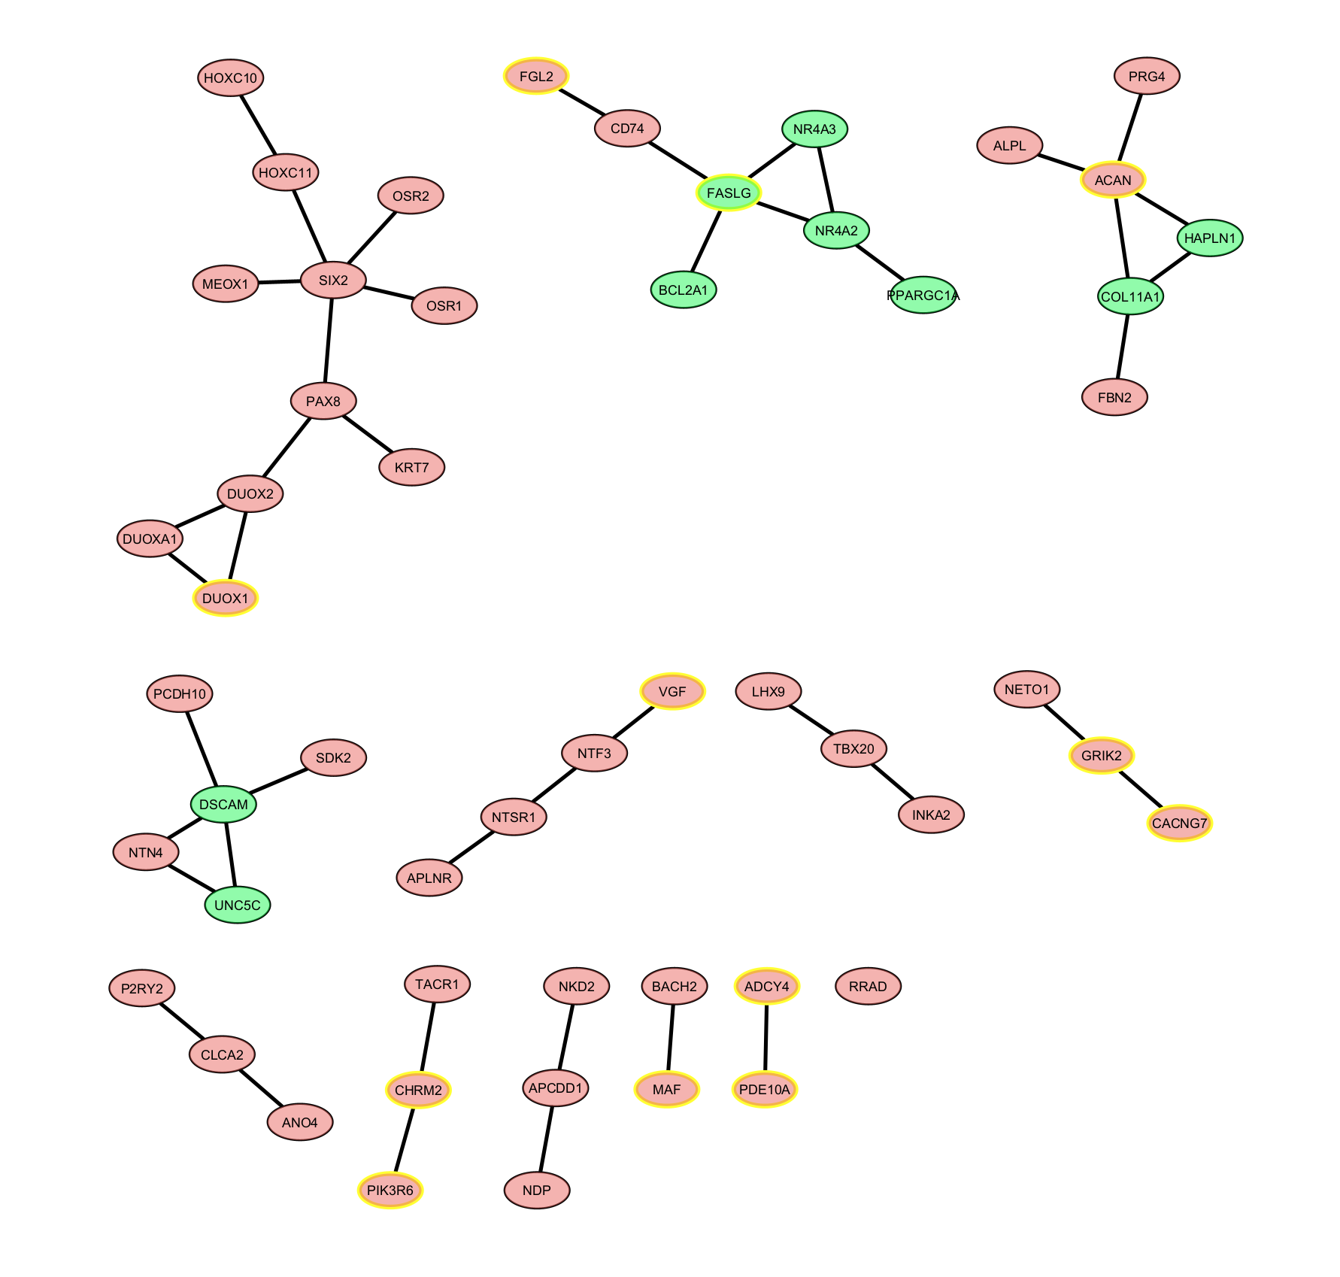
DIFFERENCES WT_TGFB-LOF_TGFB vs WT_SB-WT_TGFB
mRNA
Green: upregulated genes
Red: downregulated genes
Yellow border: genes that are in both WT-LOF vs WT-WT and WT-SGS vs WT-WT differences networks
Fuente: STRING Network from Cytoscape, version 3.10.2

Slide 31
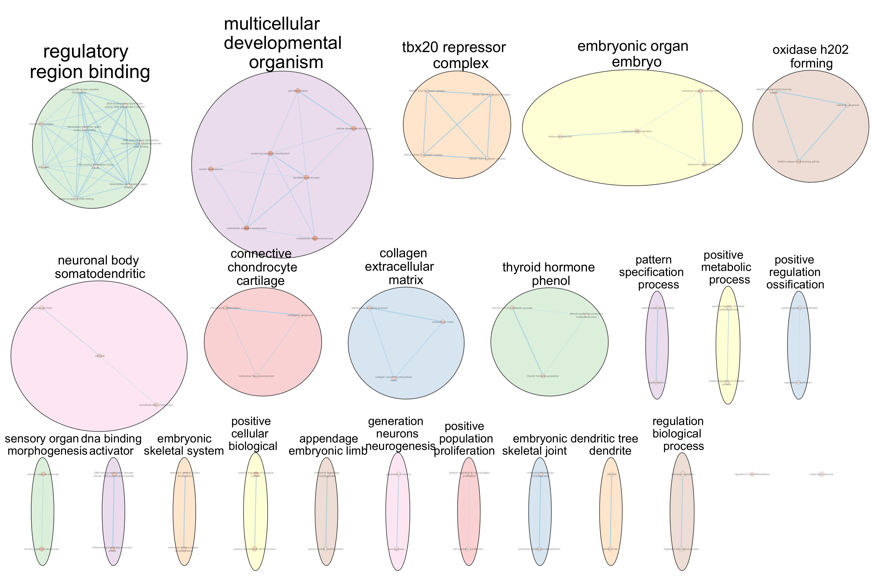
DIFFERENCES WT-LOF vs WT-WT
mRNA
Fuente: AutoAnnotate Clustering from Cytoscape, version 3.10.2
Notes:
We can download the genes table that are in each cluster

Slide 32
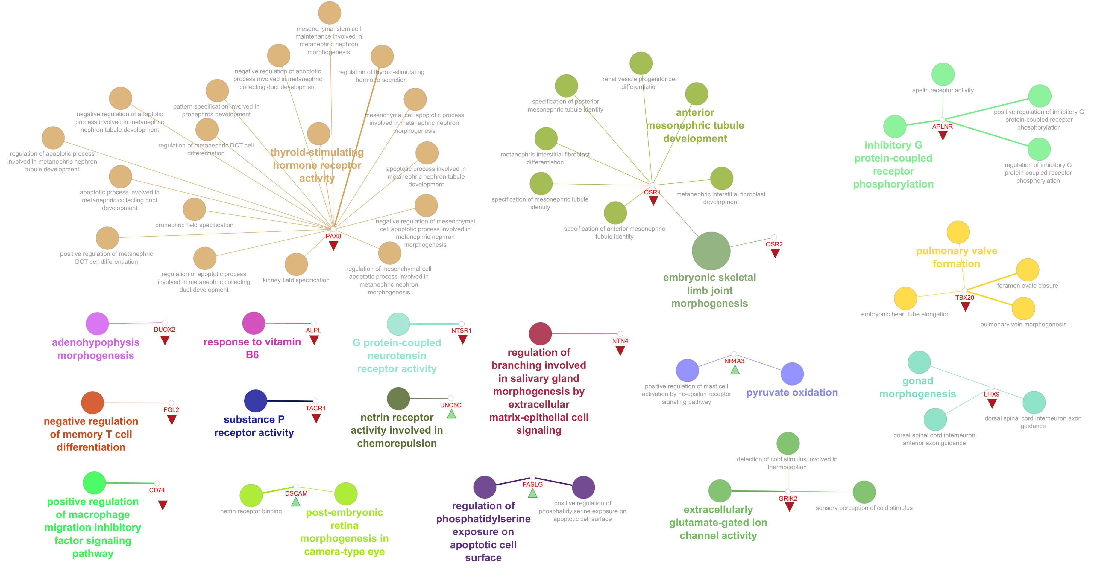
DIFFERENCES WT-LOF vs WT-WT
mRNA
Fuente: ClueGO and CluePedia Bio-Process from Cytoscape, version 3.10.2

Slide 33
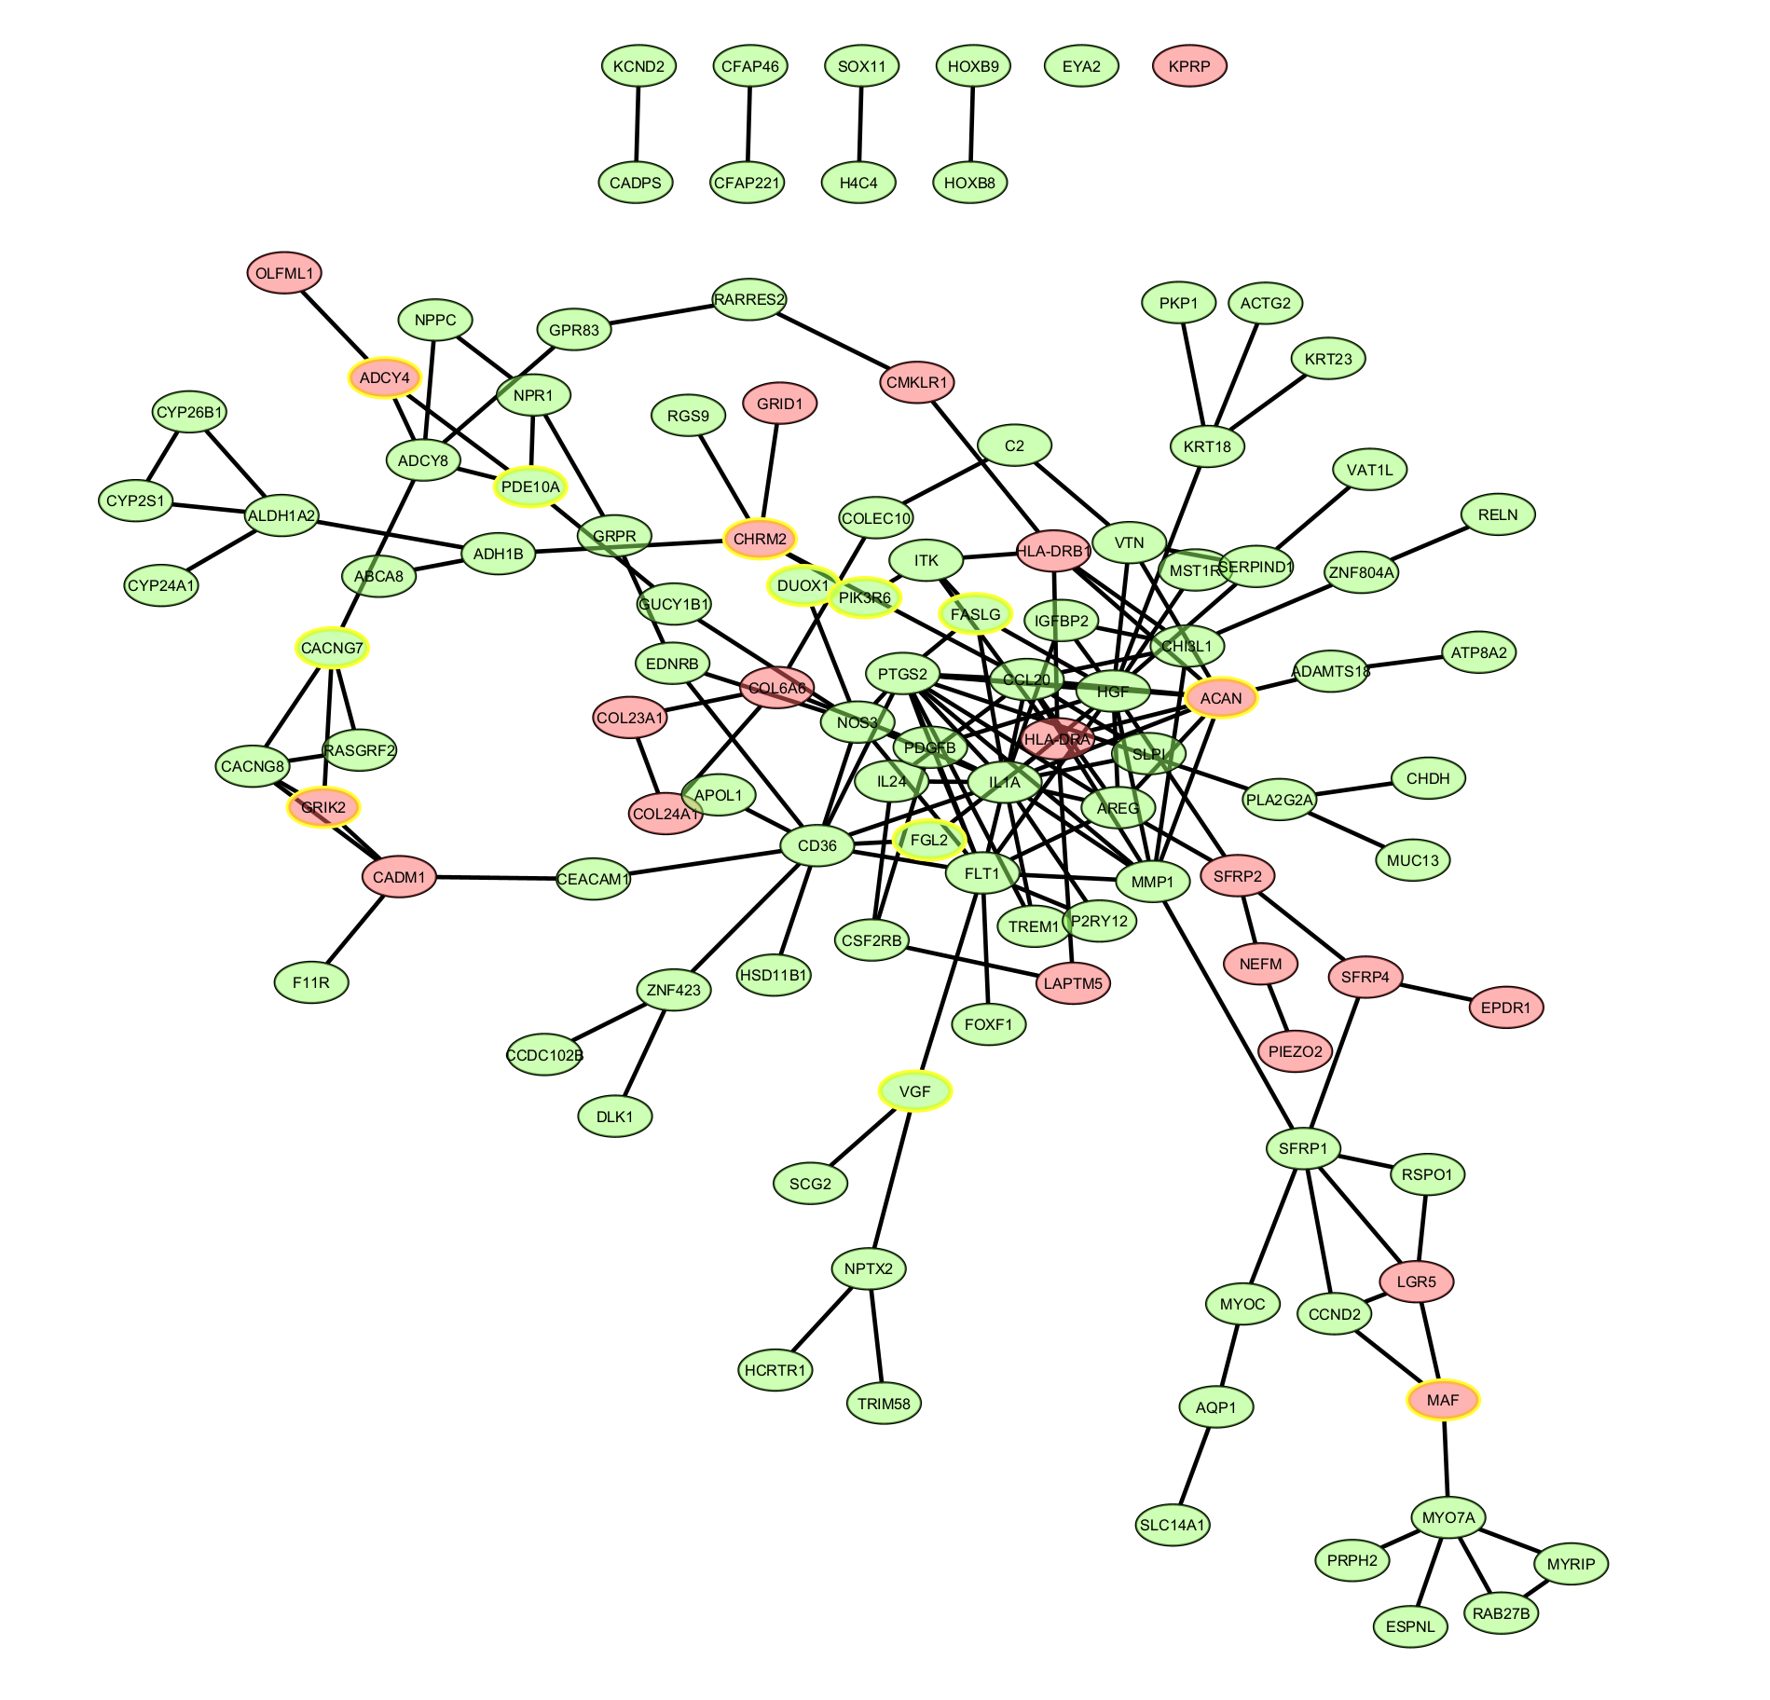
DIFFERENCES WT_TGFB-SGS_TGFB vs WT_SB-WT_TGFB
mRNA
Green: upregulated genes
Red: downregulated genes
Yellow border: genes that are in both WT-LOF vs WT-WT and WT-SGS vs WT-WT differences networks
Fuente: STRING Network from Cytoscape, version 3.10.2

Slide 34
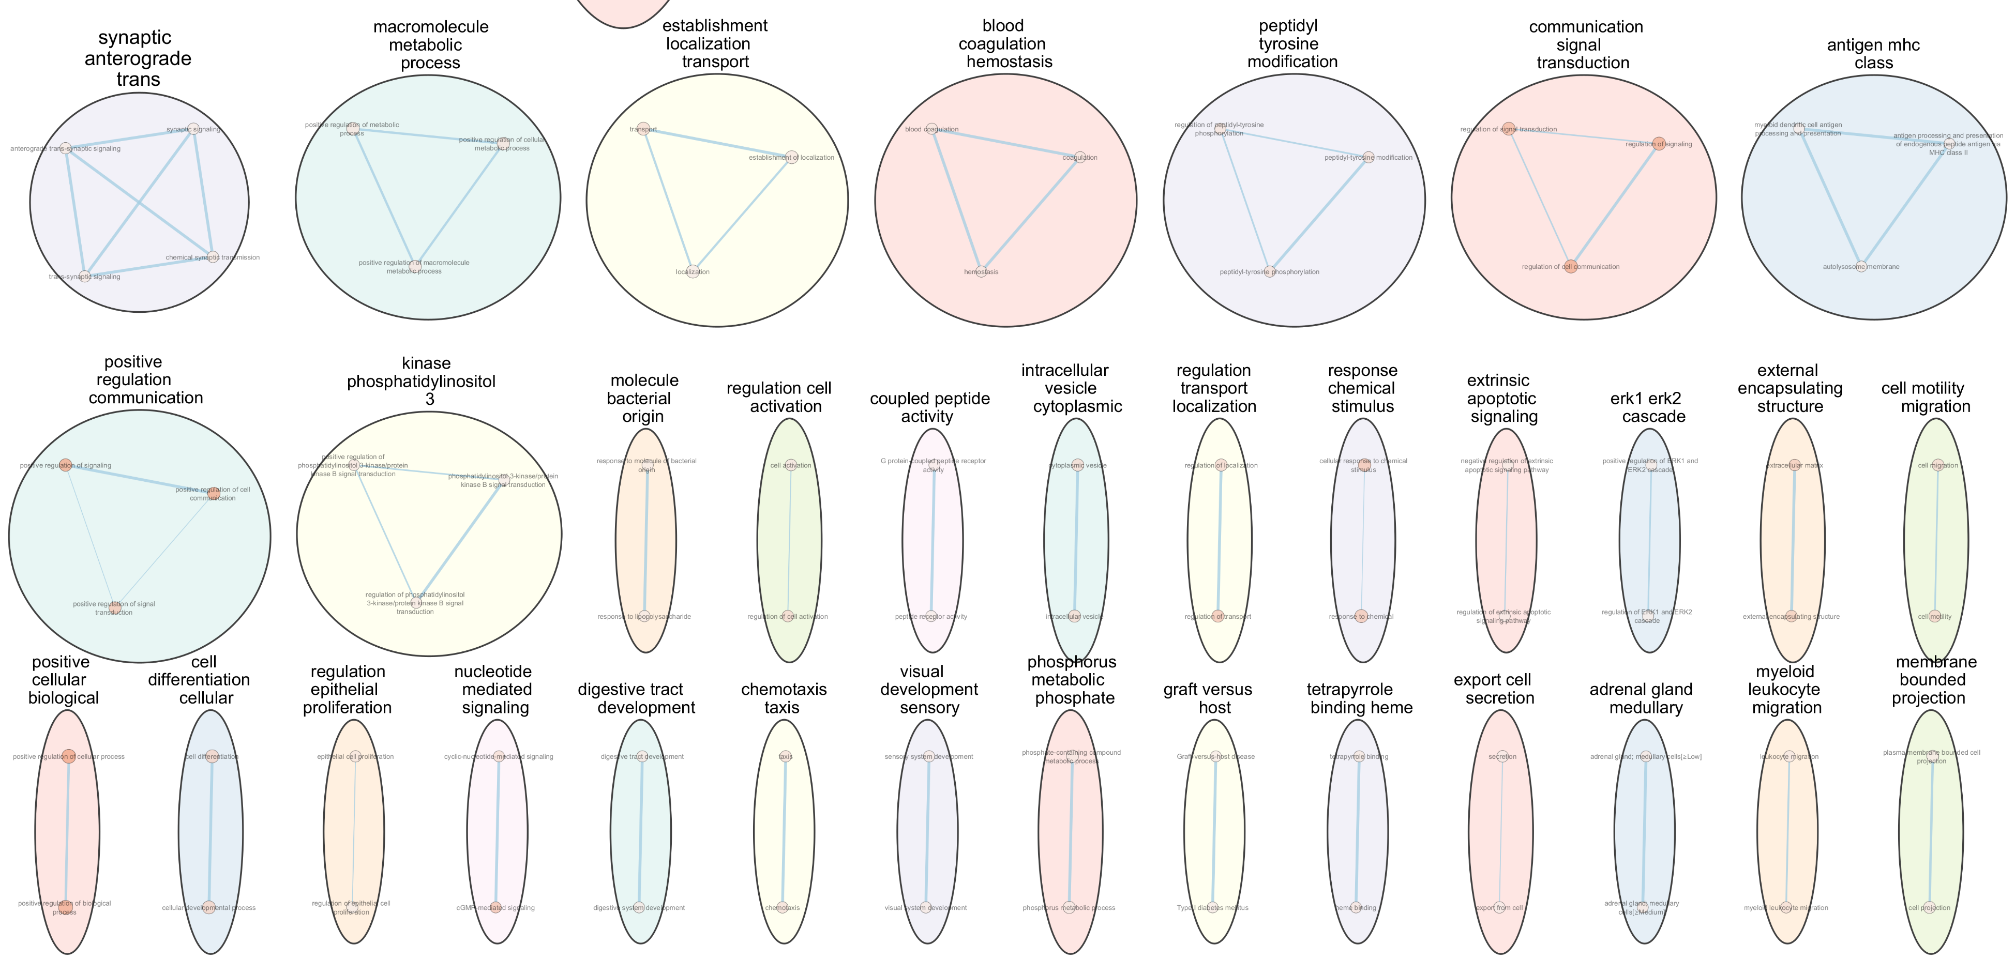
DIFFERENCES WT-SGS vs WT-WT
mRNA
*** Not all enrichment clusters are included
Fuente: AutoAnnotate Clustering from Cytoscape, version 3.10.2
Notes:
We can download the genes table that are in each cluster

Slide 35
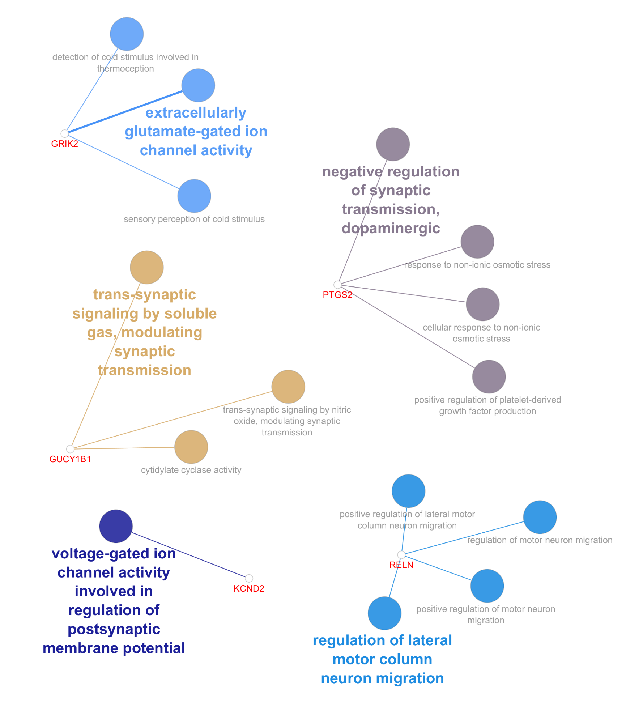
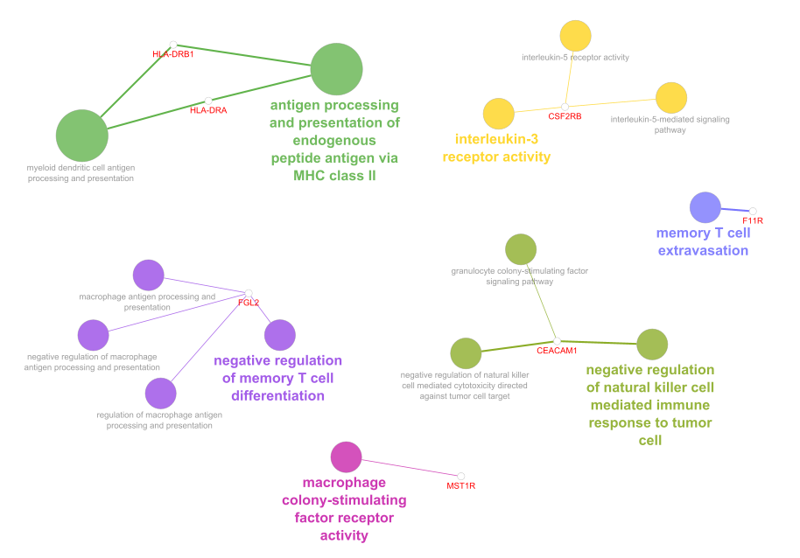
DIFFERENCES WT-SGS vs WT-WT
mRNA
Fuente: ClueGO and CluePedia Bio-Process from Cytoscape, version 3.10.2

Slide 36
PROTEIN
Due to the large number of genes that comprise the networks, that cause a lower resolution of the images, here it is attached all the STRING links :
WT_SB – WT_TGFB (Sample 1): https://version-12-0.string-db.org/cgi/link?to=FF18AE6D6A580C2C
WT_SB – WT_TGFB (Sample 4): https://version-12-0.string-db.org/cgi/link?to=06A43A7CD7DEC3D4
LOF_SB – LOF_TGF (Samples 1 & 2): https://version-12-0.string-db.org/cgi/link?to=3576BCDE41D9855A
SGS_SB – SGS_TGFB (Samples 2 & 3): https://version-12-0.string-db.org/cgi/link?to=4A12C22757EC5918

Slide 37
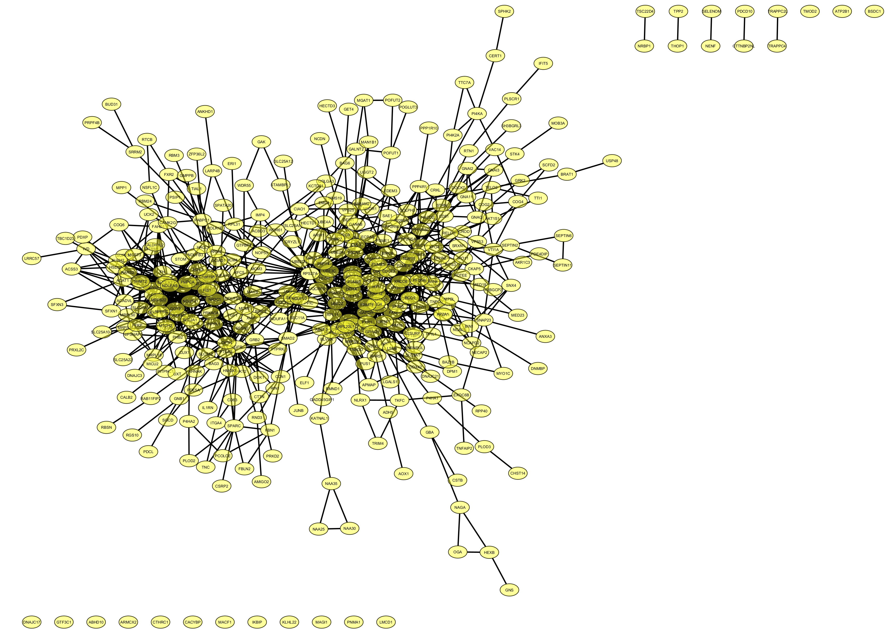
PROTEIN
DIFFERENCES LOF (1,2) – WT (1,4)
Fuente: STRING Network from Cytoscape, version 3.10.2

Slide 38

PROTEIN
DIFFERENCES LOF (1,2) – WT (1,4)
Fuente: AutoAnnotate Clustering from Cytoscape, version 3.10.2
Notes:
We can download the genes table that are in each cluster

Slide 39

PROTEIN
DIFFERENCES SGS (1,2) – WT (1,4)
Fuente: STRING Network from Cytoscape, version 3.10.2

Slide 40

PROTEIN
DIFFERENCES SGS (1,2) – WT (1,4)
*** Not all enrichment clusters are included
Fuente: AutoAnnotate Clustering from Cytoscape, version 3.10.2
Notes:
We can download the genes table that are in each cluster

Slide 41

PROTEIN
DIFFERENCES SGS (2,3) – LOF (1,2)
Fuente: STRING Network from Cytoscape, version 3.10.2

Slide 42

PROTEIN
DIFFERENCES SGS (2,3) – LOF (1,2)
Fuente: AutoAnnotate Clustering from Cytoscape, version 3.10.2
Notes:
We can download the genes table that are in each cluster

Slide 43

PROTEIN
DIFFERENCES LOF (1,2) – SGS (2,3)
Fuente: STRING Network from Cytoscape, version 3.10.2

Slide 44


PROTEIN
DIFFERENCES LOF (1,2) – SGS (2,3)
*** Not all enrichment clusters are included
Fuente: AutoAnnotate Clustering from Cytoscape, version 3.10.2
Notes:
We can download the genes table that are in each cluster

Slide 45
MORE INFORMATION
STRING mRNA NETWORKS LINKS
WT-WT: https://version-12-0.string-db.org/cgi/link?to=4994FA57A9A179FC
WT-LOF: https://version-12-0.string-db.org/cgi/link?to=01A17E84CC543547
WT-SGS: https://version-12-0.string-db.org/cgi/link?to=5C74B842690F789B
LOF-LOF: https://version-12-0.string-db.org/cgi/link?to=3D016292E8278790
SGS-SGS: https://version-12-0.string-db.org/cgi/link?to=AA0532696C36C36F
SGS_TGF-LOF_TGF: https://version-12-0.string-db.org/cgi/link?to=1E5BCFF9661E4085
STRING PROTEIN NETWORKS LINKS
WT(1,3,4) -> https://version-12-0.string-db.org/cgi/link?to=36D2006083836362
WT(1) -> https://version-12-0.string-db.org/cgi/link?to=FF18AE6D6A580C2C
WT(4) -> https://version-12-0.string-db.org/cgi/link?to=06A43A7CD7DEC3D4
LOF(1,2) -> https://version-12-0.string-db.org/cgi/link?to=3576BCDE41D9855A
LOF(1) -> https://version-12-0.string-db.org/cgi/link?to=163634DBCF840860
LOF(2) -> https://version-12-0.string-db.org/cgi/link?to=D52D768CD9E06926
SGS(2,3) -> https://version-12-0.string-db.org/cgi/link?to=4A12C22757EC5918
CYTOSCAPE FILES WITH THE NETWORKS’ ANALYSIS
mRNA analysis: AnalysismRNA_Cytoscape_25052024.cys
Protein analysis: AnalysisProt_Cytoscape_030624.cys

